Slide 1
Linear Signals and Systems

Slide 2
Unit-1 Classification of Signals and Systems

Slide 3
Contents
Sl No. | Content | Slide No.
1 | Introduction to signal and system | 4-5
2 | Application of signal and system | 6-7
3 | Types of the signal | 8-11
4 | Elementary continuous time signals | 12-28
5 | Representation of discrete time signal | 29-33
6 | Elementary discrete time signals | 34-43
7 | Basic operations on signal | 44-65
8 | Classification of signals | 66-107
9 | Classification of systems | 108-149

Slide 4
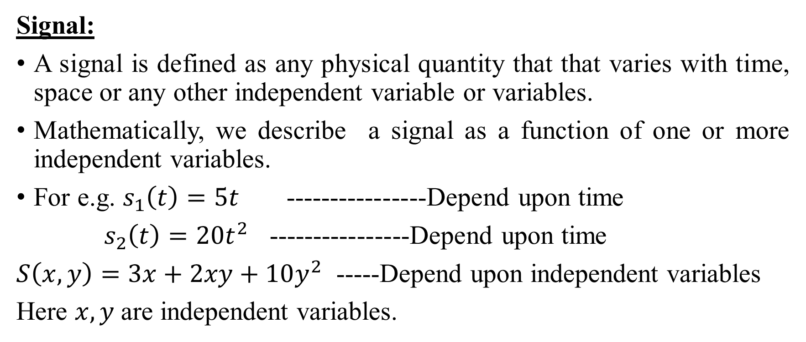
Introduction to signal and system
Signal:
A signal is defined as any physical quantity that that varies with time, space or any other independent variable or variables.
Mathematically, we describe a signal as a function of one or more independent variables.
For e.g. $s_{1}\left(t\right)=5t$ ----------------Depend upon time
$s_{2}\left(t\right)=20t^{2}$ ----------------Depend upon time
$S\left(x,y\right)=3x+2xy+10y^{2}$ -----Depend upon independent variables
Here $x,y$are independent variables.

Slide 5
Introduction to signal and system (Cont.)
System:
A system is defined as a physical device or software realization that performs an operation on a signal.
For e.g.
Filtering:- removal of noise from the signal.
noise is unwanted signal which is added to the desired signal.

Slide 6
Application of signals and systems
Control application: Used in industrial control and automation.
e.g:- Controlling the position of a valve or shaft of amotor.
Important techniques used in it are : time-domain solution of differential equations
Laplace transformation,
Stability estimation

Slide 7
Application of signals and systems (Cont.)
Communication applications:
Communication is transformation of information (signal) over a channel. The channel may be free space, coaxial cable, fiber optic cable
A Key component of transmission is modulation:
analog modulation digital modulation
Signal and system is applied in communication for transmission, storage and display of information.
Speech and audio processing:
Cancellation of noise
Extraction of features
Analysis of signal.

Slide 8
Types of signals
Continuous-time signal (analog signal)
Discrete-time signal
Digital signal
In signal and system course, we will cover operation on analog signal and discrete time signal.

Slide 9
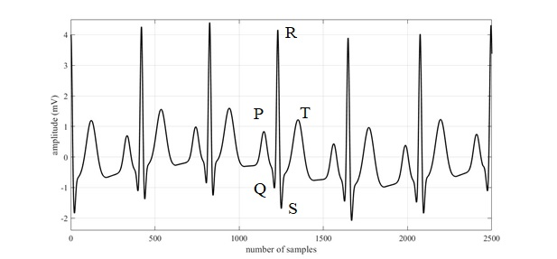
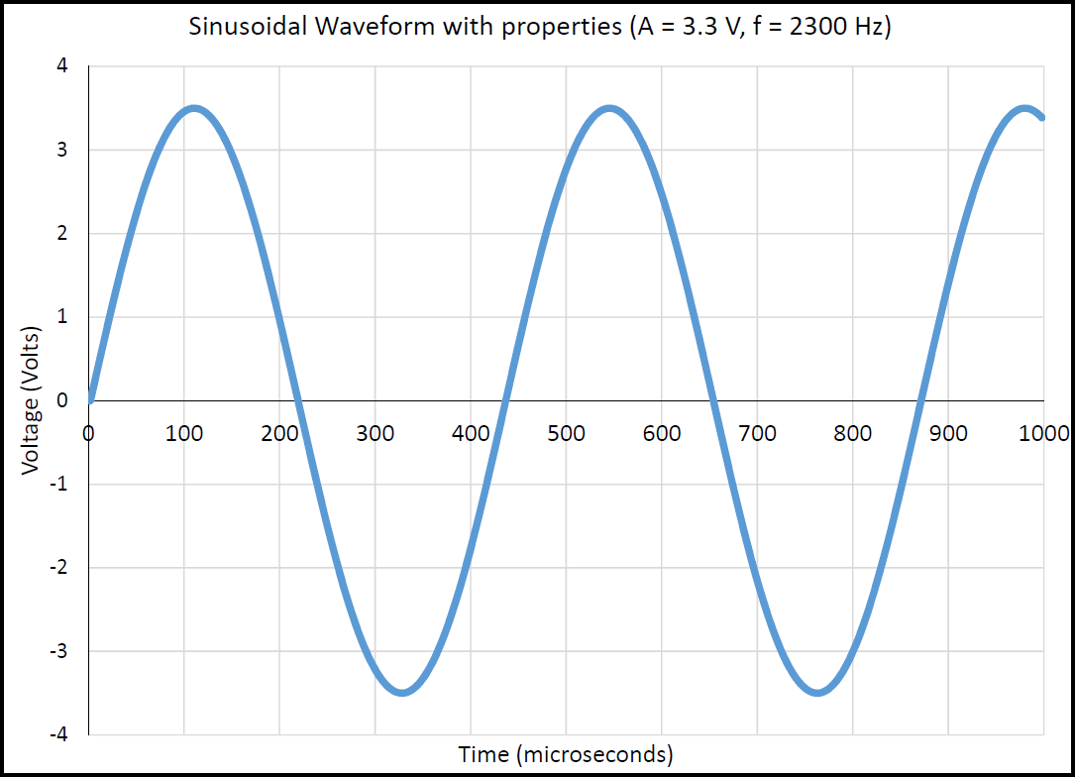
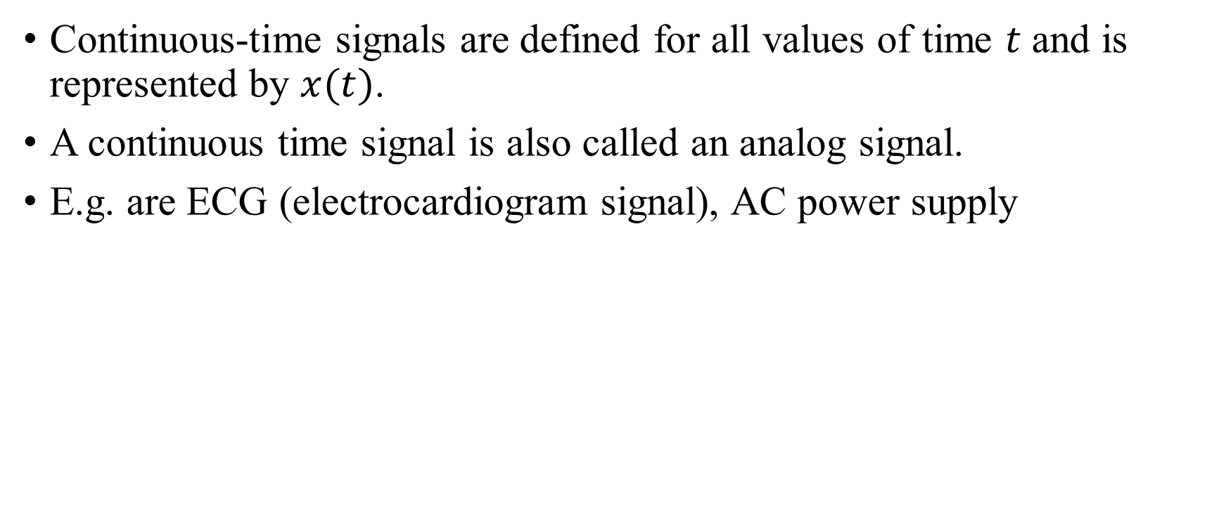
Continuous-time signal (analog signal)
Continuous-time signals are defined for all values of time $t$ and is represented by $x(t)$.
A continuous time signal is also called an analog signal.
E.g. are ECG (electrocardiogram signal), AC power supply
Fig.1. ECG signal
Fig. 2. AC power supply

Slide 10
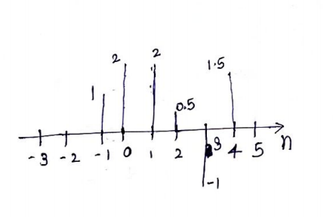
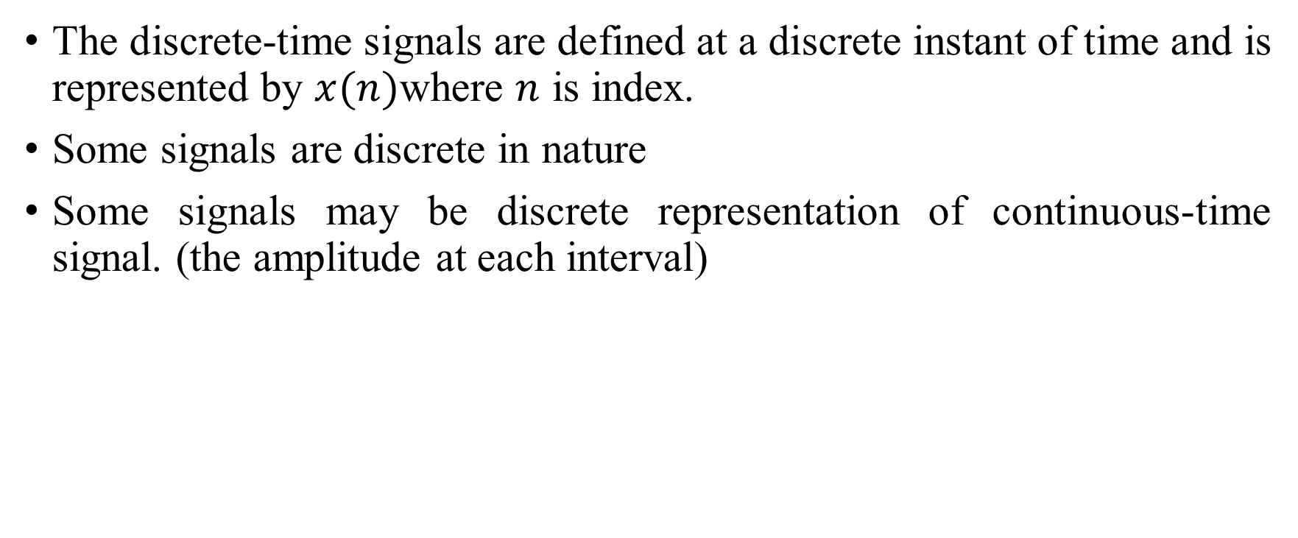
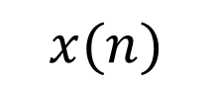
Discrete-time signal
The discrete-time signals are defined at a discrete instant of time and is represented by $x(n)$where $n$ is index.
Some signals are discrete in nature
Some signals may be discrete representation of continuous-time signal. (the amplitude at each interval)
$$x(n)$$

Slide 11
Digital signals
A signal that is discretized in time and quantized in amplitude is known as digital signal.
The signal consists of binary values (zeros or ones).

Slide 12
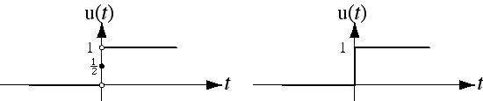
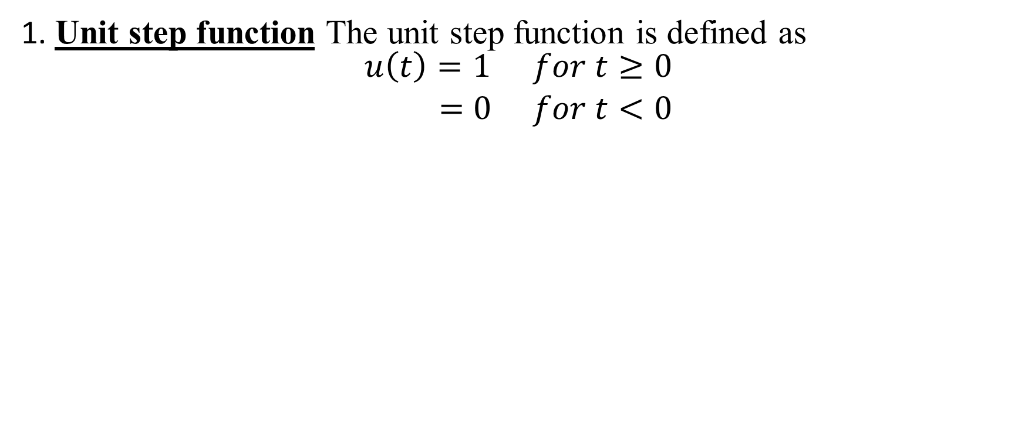
Elementary continuous time signals
1. Unit step function The unit step function is defined as
$$\begin{matrix}u\left(t\right)=1 & for t≥0 \\ =0 & for t<0\end{matrix}$$
Precise Graph
Commonly-Used Graph

Slide 13
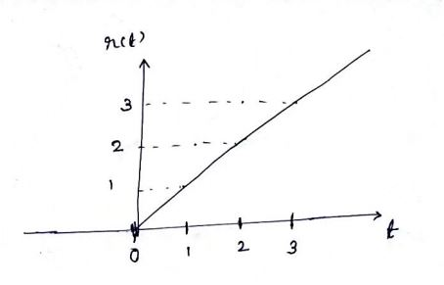
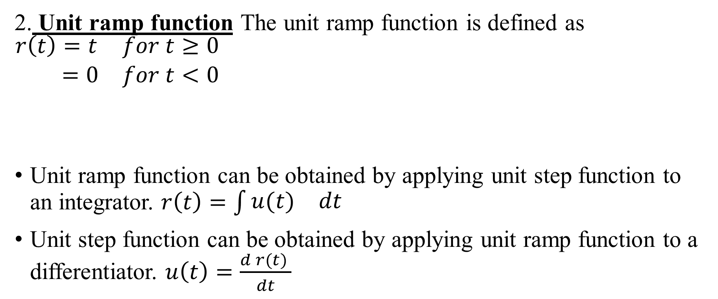
Elementary continuous time signals (cont.)
2. Unit ramp function The unit ramp function is defined as $\begin{matrix}r\left(t\right)=t & for t≥0 \\ =0 & for t<0\end{matrix}$
Unit ramp function can be obtained by applying unit step function to an integrator. $r\left(t\right)=\int{\begin{matrix}u(t) & dt\end{matrix}}$
Unit step function can be obtained by applying unit ramp function to a differentiator. $u\left(t\right)=\frac{d r(t) }{dt}$

Slide 14
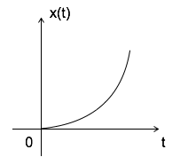
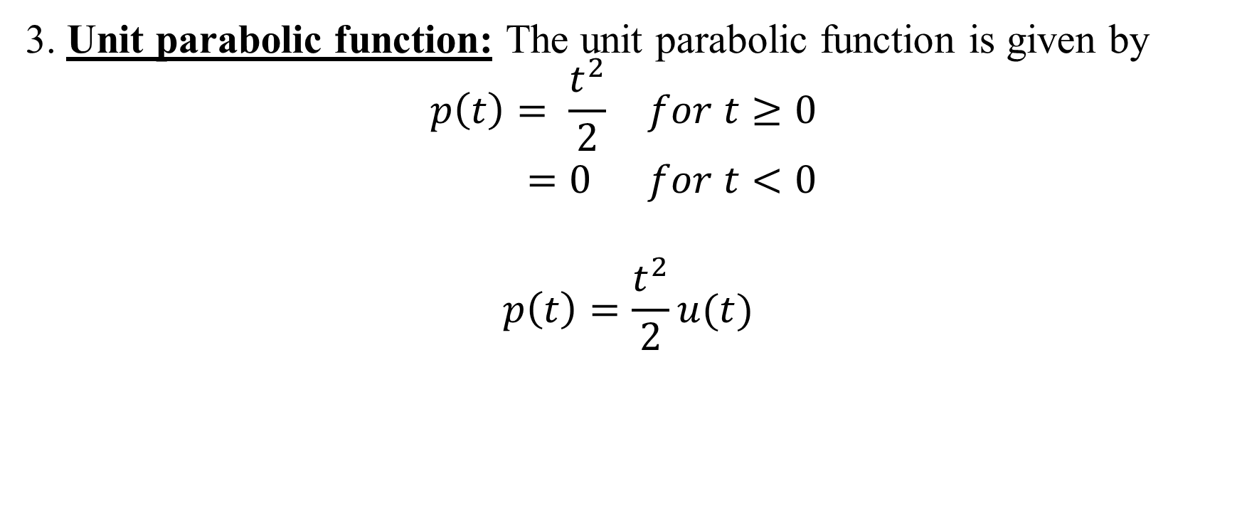
Elementary continuous time signals (cont.)
3. Unit parabolic function: The unit parabolic function is given by
$$\begin{matrix}p\left(t\right)= \frac{t^{2}}{2} & for t≥0 \\ =0 & for t<0\end{matrix}$$
$$p\left(t\right)=\frac{t^{2}}{2}u(t)$$

Slide 15
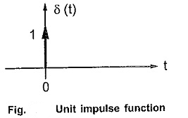

Elementary continuous time signals (cont.)
4. Unit impulse function: Unit impulse function is defined as
Area of unit impulse function is 1
$$\begin{matrix}δ(t)=1 & for t=0 \\ =0 & for t≠0\end{matrix}$$

Slide 16
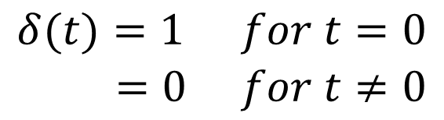
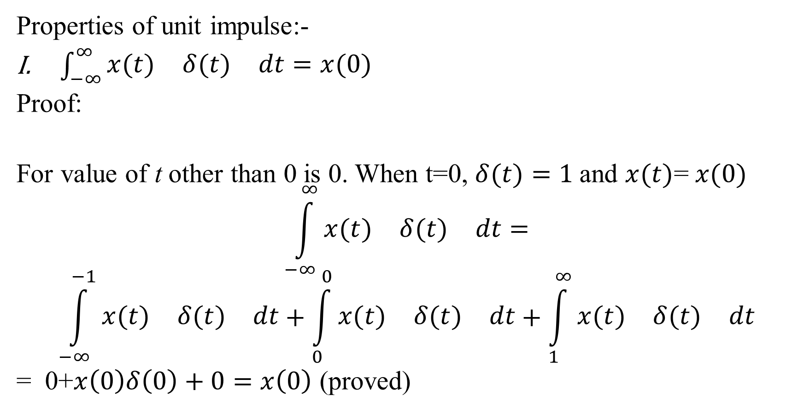
Elementary continuous time signals (cont.)
Properties of unit impulse:-
$\int_{−∞}^{∞}{\begin{matrix}x(t) & δ(t) & dt=x(0)\end{matrix}}$
Proof:
For value of t other than 0 is 0. When t=0, $δ(t)=1$and $x(t)$= $x(0)$
$$\int_{−∞}^{∞}{\begin{matrix}x(t) & δ(t) & dt=\end{matrix}}$$
$$\int_{−∞}^{−1}{\begin{matrix}x(t) & δ(t) & dt\end{matrix}}+\int_{0}^{0}{\begin{matrix}x(t) & δ(t) & dt\end{matrix}}+\int_{1}^{∞}{\begin{matrix}x(t) & δ(t) & dt\end{matrix}}$$
= 0+$x\left(0\right)δ\left(0\right)+0=x\left(0\right)$ (proved)
$$\begin{matrix}δ(t)=1 & for t=0 \\ =0 & for t≠0\end{matrix}$$

Slide 17
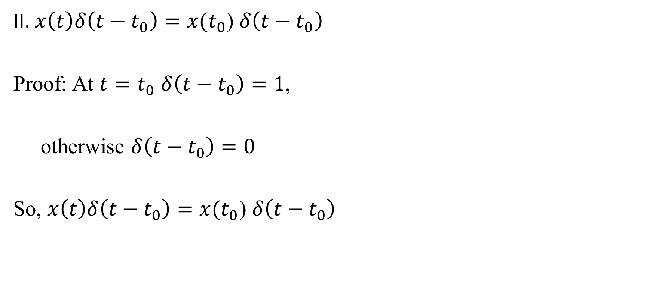
Elementary continuous time signals (cont.)
II. $x\left(t\right)δ\left(t−t_{0}\right)=x(t_{0}$) $δ\left(t−t_{0}\right)$
Proof: At $t=t_{0}$ $δ\left(t−t_{0}\right)=1$,
otherwise $δ\left(t−t_{0}\right)=0$
So, $x\left(t\right)δ\left(t−t_{0}\right)=x(t_{0}$) $δ\left(t−t_{0}\right)$

Slide 18
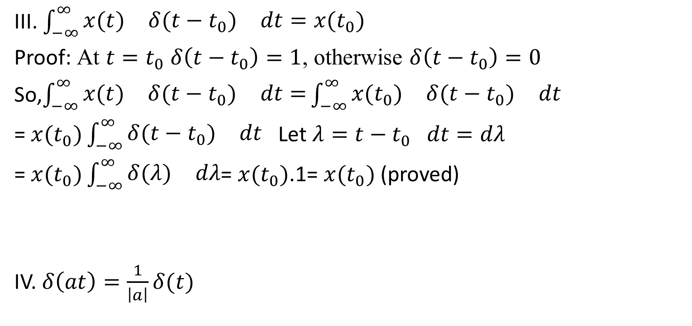
Elementary continuous time signals (cont.)
III. $\int_{−∞}^{∞}{\begin{matrix}x(t) & δ(t−t_{0}) & dt=x(t_{0})\end{matrix}}$
Proof: At $t=t_{0}$ $δ\left(t−t_{0}\right)=1$, otherwise $δ\left(t−t_{0}\right)=0$
So,$\int_{−∞}^{∞}{\begin{matrix}x(t) & δ(t−t_{0}) & dt=\end{matrix}}\int_{−∞}^{∞}{\begin{matrix}x(t_{0}) & δ(t−t_{0}) & dt\end{matrix}}$
= $x(t_{0})\int_{−∞}^{∞}{\begin{matrix}δ(t−t_{0}) & dt\end{matrix}}$ Let $λ=t−t_{0}$ $dt=dλ$
= $x(t_{0})\int_{−∞}^{∞}{\begin{matrix}δ(λ) & dλ\end{matrix}}$= $x(t_{0})$.1= $x(t_{0})$ (proved)
IV. $δ\left(at\right)=\frac{1}{\left|a\right|}δ(t)$

Slide 19
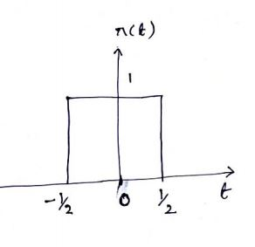
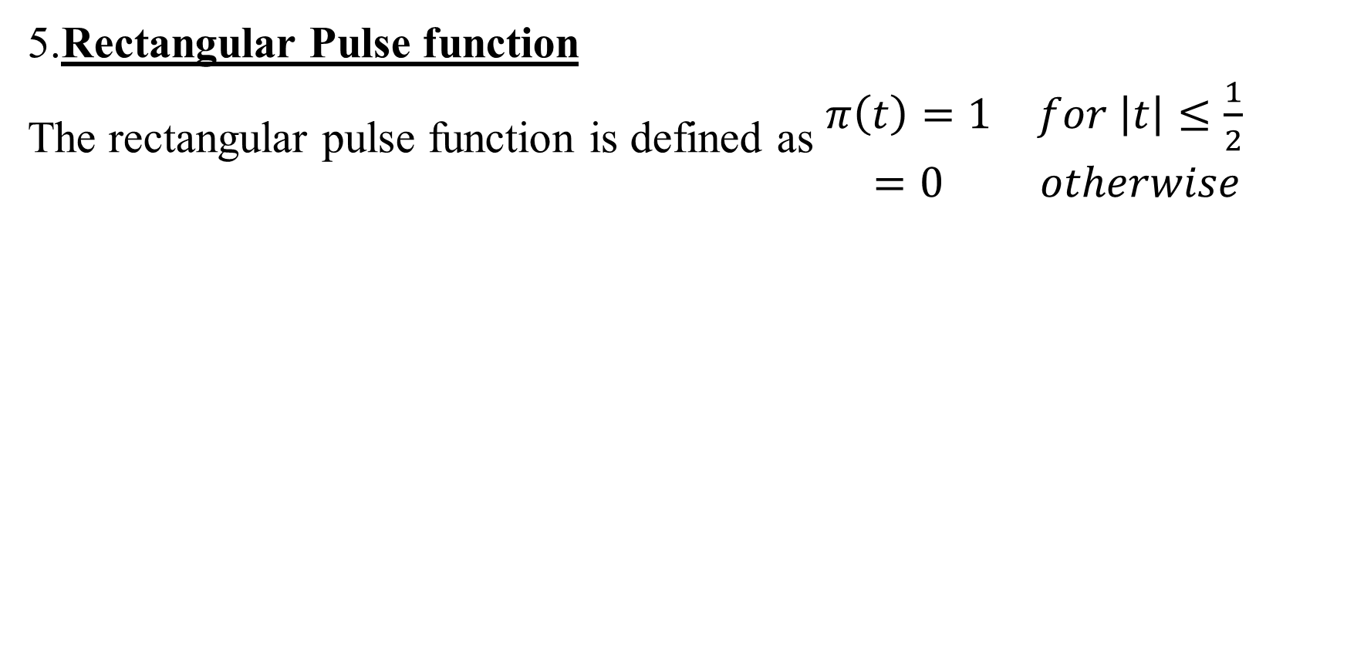
Elementary continuous time signals (cont.)
5.Rectangular Pulse function
The rectangular pulse function is defined as $\begin{matrix}π\left(t\right)=1 & for \left|t\right|≤\frac{1}{2} \\ =0 & otherwise\end{matrix}$

Slide 20
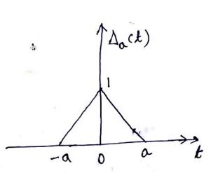
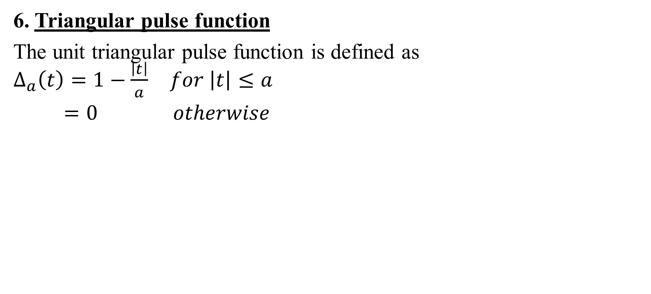
Elementary continuous time signals (cont.)
6. Triangular pulse function
The unit triangular pulse function is defined as $\begin{matrix}∆_{a}\left(t\right)=1−\frac{\left|t\right|}{a} & for \left|t\right|≤a \\ =0 & otherwise\end{matrix}$

Slide 21
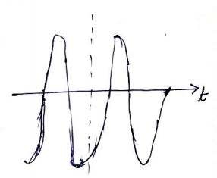
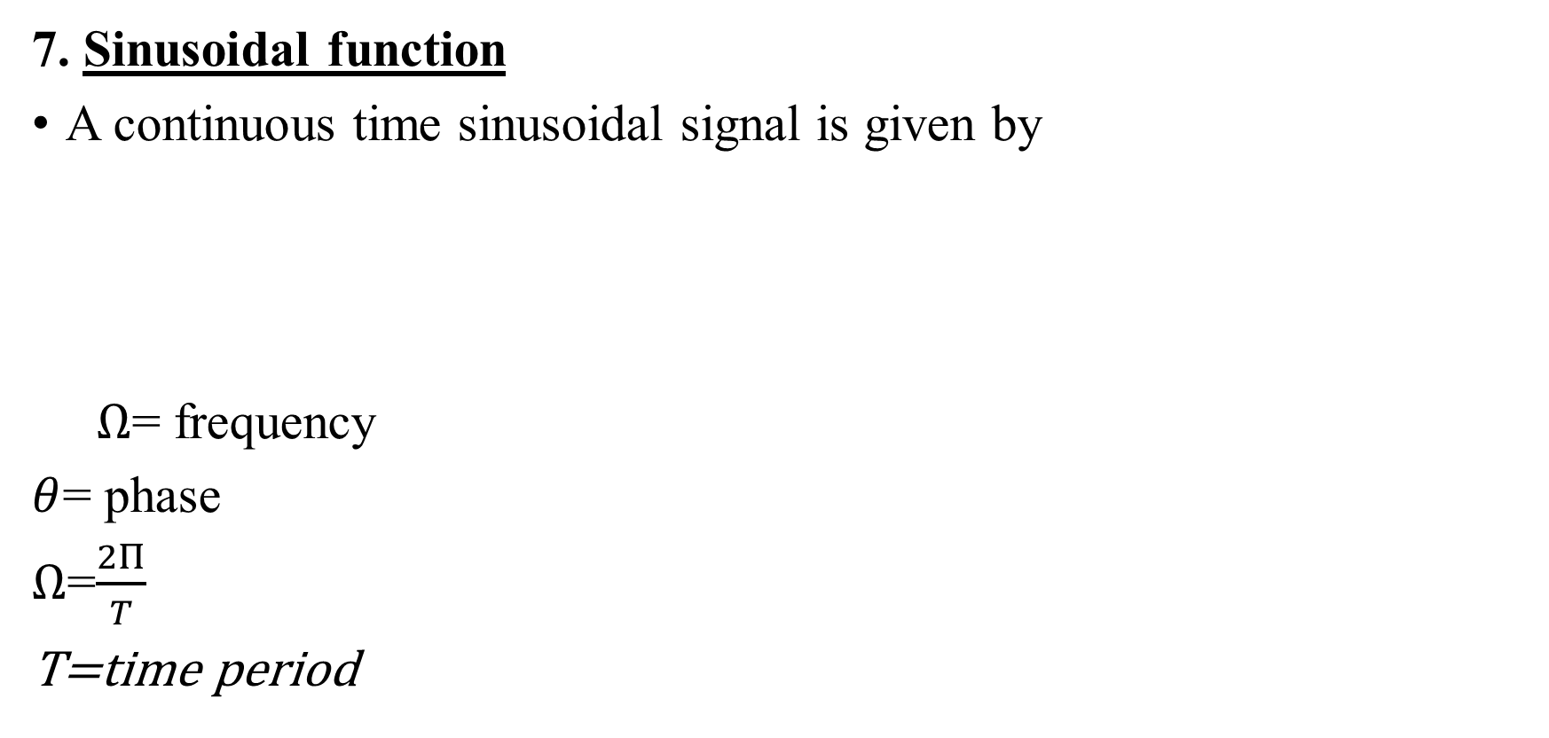
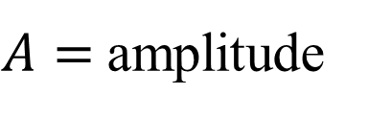
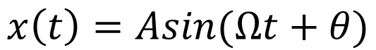
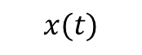
Elementary continuous time signals (cont.)
7. Sinusoidal function
A continuous time sinusoidal signal is given by
$Ω$= frequency
$θ$= phase
$Ω$=$\frac{2Π}{T}$
T=time period
$$x(t)$$
$$x\left(t\right)=Asin(Ωt+θ)$$
$A=$amplitude

Slide 22
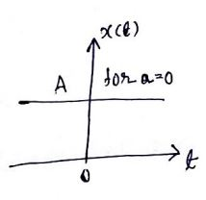
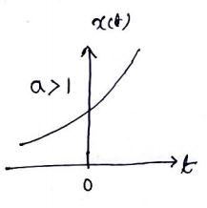
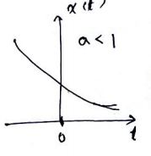
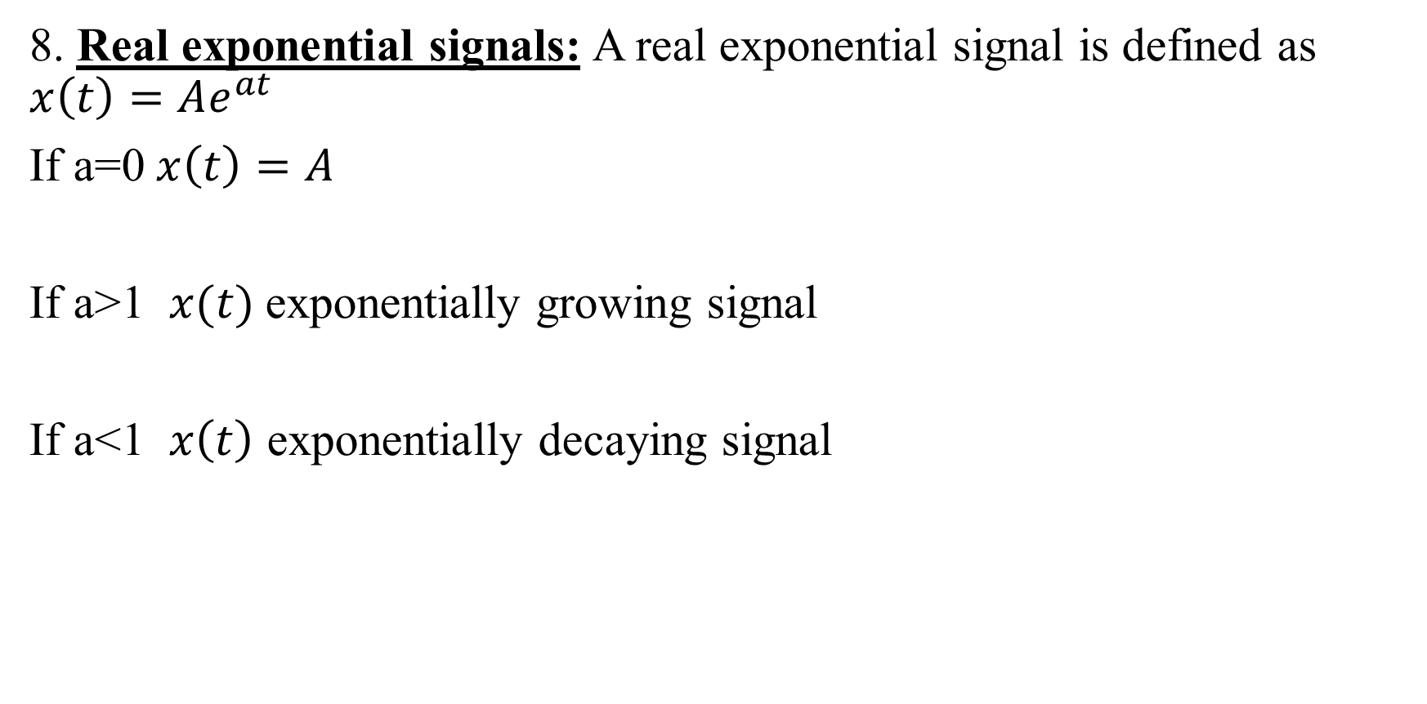
Elementary continuous time signals (cont.)
8. Real exponential signals: A real exponential signal is defined as $x\left(t\right)=Ae^{at}$
If a=0$x\left(t\right)=A$
If a>1 $x(t)$exponentially growing signal
If a<1 $x\left(t\right)$ exponentially decaying signal

Slide 23
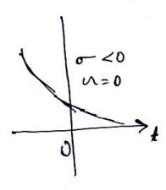
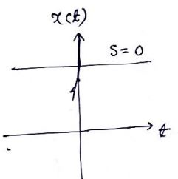
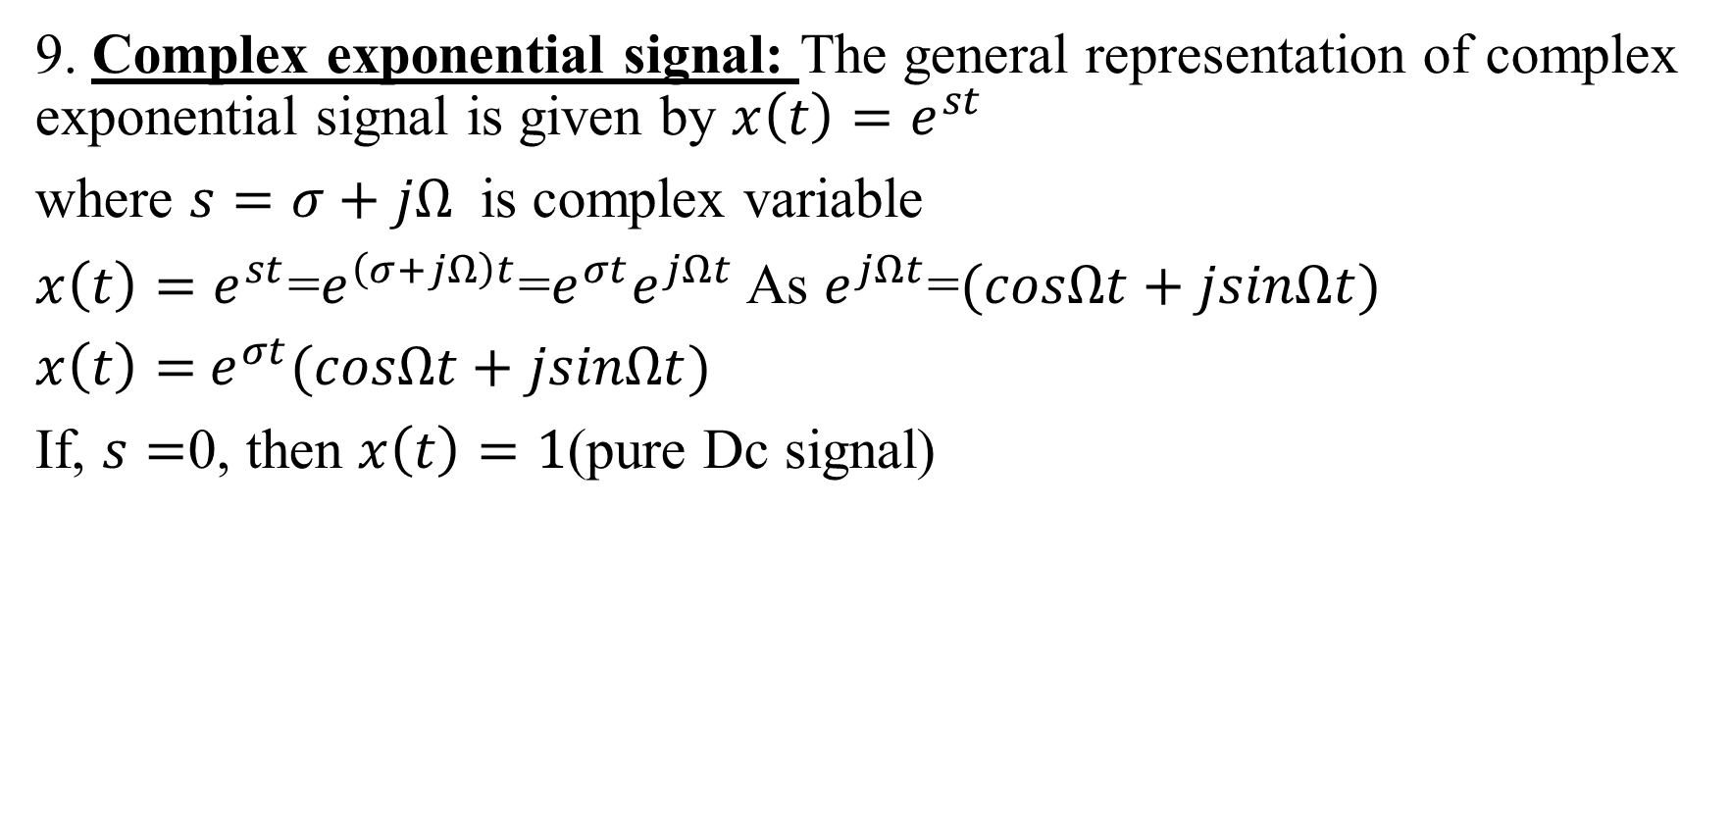
Elementary continuous time signals (cont.)
9. Complex exponential signal: The general representation of complex exponential signal is given by $x\left(t\right)=e^{st}$
where $s=σ+jΩ$ is complex variable
$x\left(t\right)=e^{st}$=$e^{\left(σ+jΩ\right)t}$=$e^{σt}e^{jΩt}$ As $e^{jΩt}$=$(cosΩt+jsinΩt)$
$x\left(t\right)=$ $e^{σt}(cosΩt+jsinΩt)$
If, $s=$0, then $x\left(t\right)=1$(pure Dc signal)
Decays exponentially

Slide 24
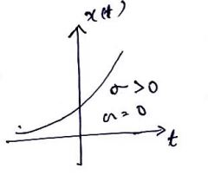
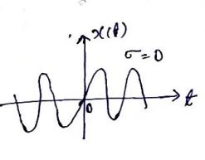
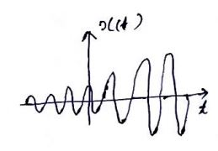
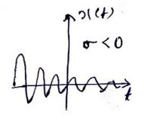
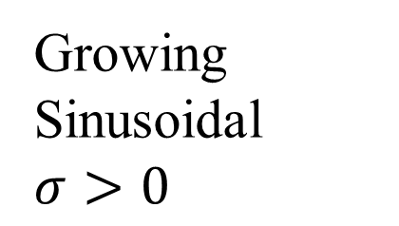
Elementary continuous time signals (cont.)
sinusoidal
Increases exponentially
Growing Sinusoidal $σ>0$
Decaying Sinusoidal

Slide 25
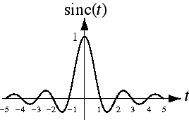
Sinc Function
sin ( π t )
π t
sinc( t ) =

Slide 26
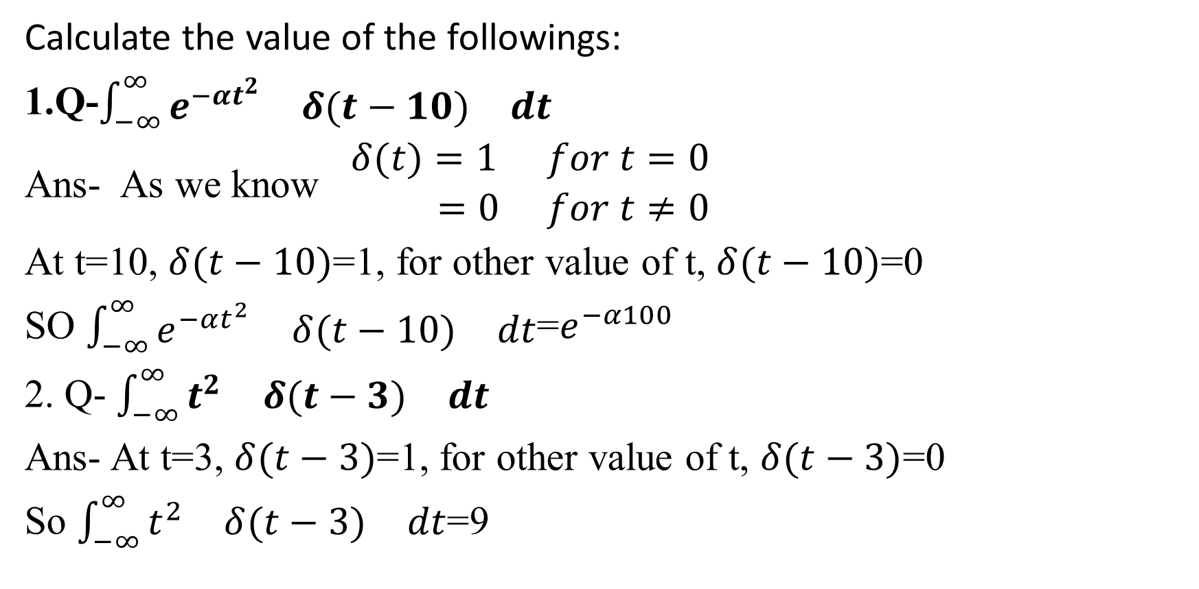
Problems:
Calculate the value of the followings:
1.Q-$\int_{−∞}^{∞}{\begin{matrix}e^{−αt^{2}} & δ(t−10) & dt\end{matrix}}$
Ans- As we know $\begin{matrix}δ(t)=1 & for t=0 \\ =0 & for t≠0\end{matrix}$
At t=10, $δ(t−10)$=1, for other value of t, $δ(t−10)$=0
SO $\int_{−∞}^{∞}{\begin{matrix}e^{−αt^{2}} & δ(t−10) & dt\end{matrix}}$=$e^{−α100}$
2. Q- $\int_{−∞}^{∞}{\begin{matrix}t^{2} & δ(t−3) & dt\end{matrix}}$
Ans- At t=3, $δ(t−3)$=1, for other value of t, $δ(t−3)$=0
So $\int_{−∞}^{∞}{\begin{matrix}t^{2} & δ(t−3) & dt\end{matrix}}$=9

Slide 27
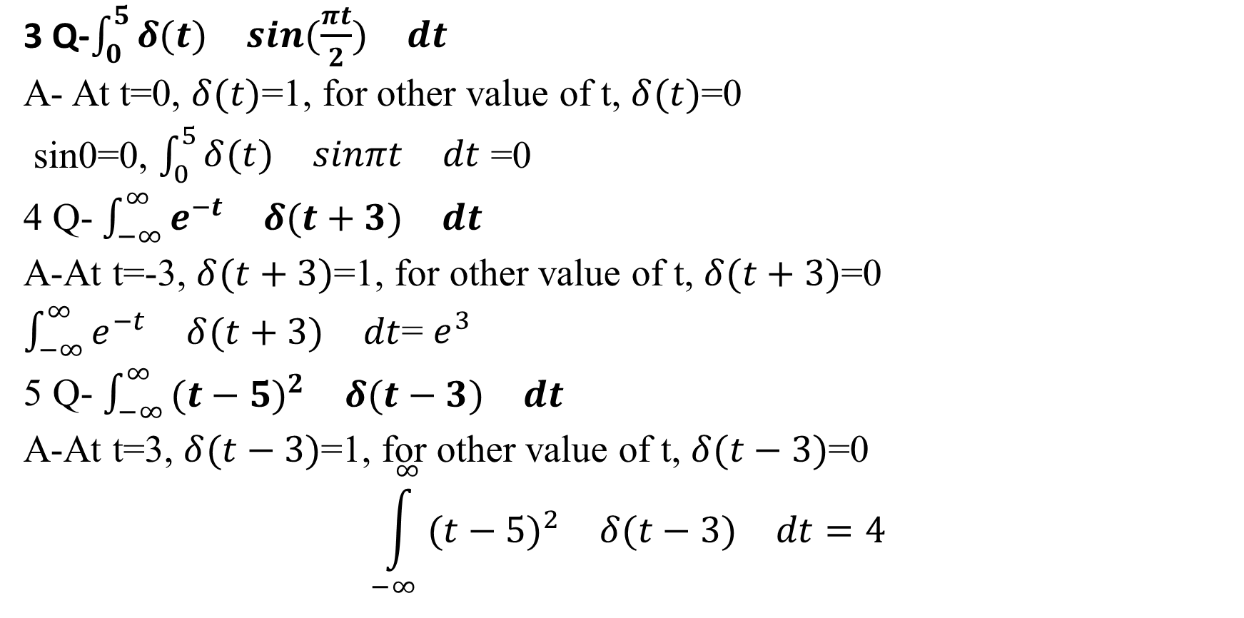
Problems (cont.):
3 Q-$\int_{0}^{5}{\begin{matrix}δ(t) & sin(\frac{πt}{2}) & dt\end{matrix}}$
A- At t=0, $δ(t)$=1, for other value of t, $δ(t)$=0
sin0=0, $\int_{0}^{5}{\begin{matrix}δ(t) & sinπt & dt\end{matrix}}$ =0
4 Q- $\int_{−∞}^{∞}{\begin{matrix}e^{−t} & δ(t+3) & dt\end{matrix}}$
A-At t=-3, $δ(t+3)$=1, for other value of t, $δ(t+3)$=0
$\int_{−∞}^{∞}{\begin{matrix}e^{−t} & δ(t+3) & dt\end{matrix}}$= $e^{3}$
5 Q- $\int_{−∞}^{∞}{\begin{matrix}{(t−5)}^{2} & δ(t−3) & dt\end{matrix}}$
A-At t=3, $δ(t−3)$=1, for other value of t, $δ(t−3)$=0
$$\int_{−∞}^{∞}{\begin{matrix}{(t−5)}^{2} & δ(t−3) & dt=4\end{matrix}}$$

Slide 28
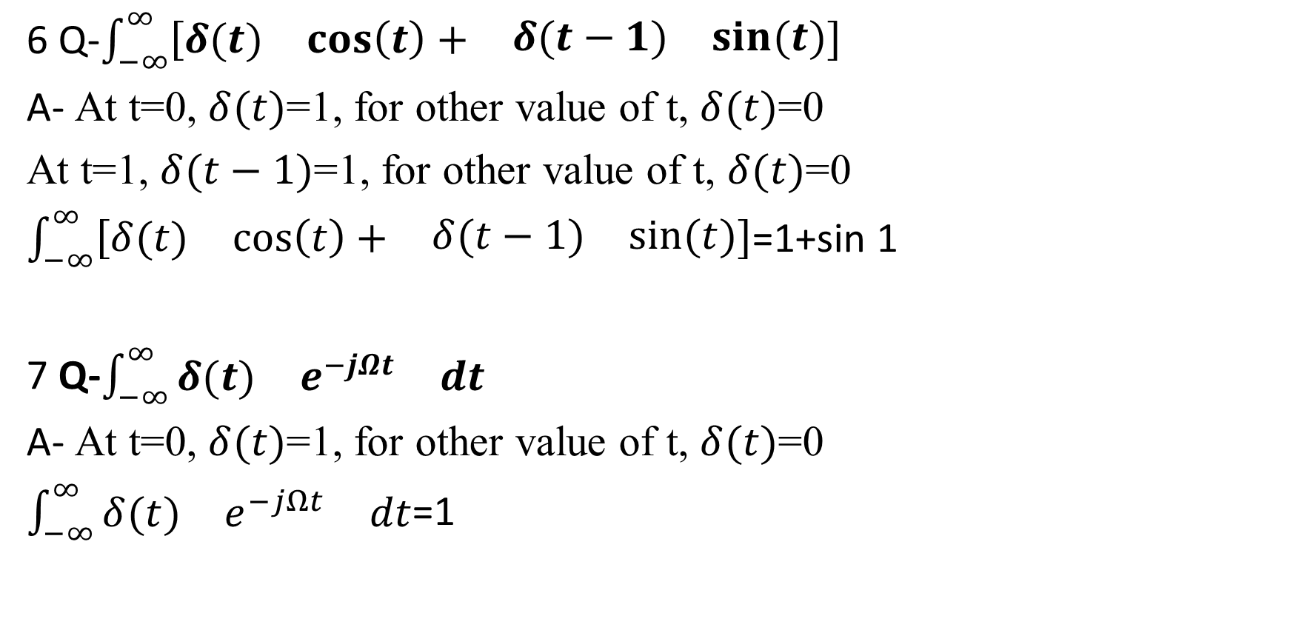
Problems (cont.):
6 Q-$\int_{−∞}^{∞}{\left[\begin{matrix}δ(t) & \cos\left(t\right)+ & \begin{matrix}δ(t−1) & sin⁡(t)\end{matrix}\end{matrix}\right]}$
A- At t=0, $δ(t)$=1, for other value of t, $δ(t)$=0
At t=1, $δ(t−1)$=1, for other value of t, $δ(t)$=0
$\int_{−∞}^{∞}{\left[\begin{matrix}δ(t) & \cos\left(t\right)+ & \begin{matrix}δ(t−1) & sin⁡(t)\end{matrix}\end{matrix}\right]}$=1+sin 1
7 Q-$\int_{−∞}^{∞}{\begin{matrix}δ(t) & e^{−jΩt} & dt\end{matrix}}$
A- At t=0, $δ(t)$=1, for other value of t, $δ(t)$=0
$\int_{−∞}^{∞}{\begin{matrix}δ(t) & e^{−jΩt} & dt\end{matrix}}$=1

Slide 29
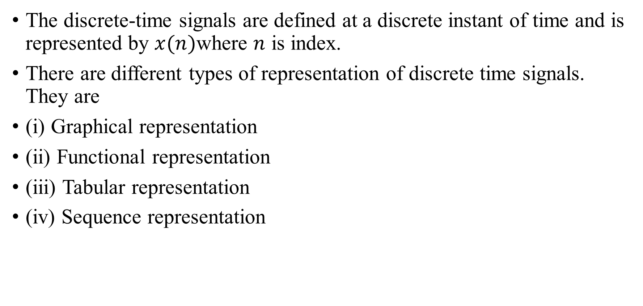
Representation of discrete-time signal
The discrete-time signals are defined at a discrete instant of time and is represented by $x(n)$where $n$ is index.
There are different types of representation of discrete time signals. They are
(i) Graphical representation
(ii) Functional representation
(iii) Tabular representation
(iv) Sequence representation

Slide 30
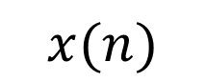
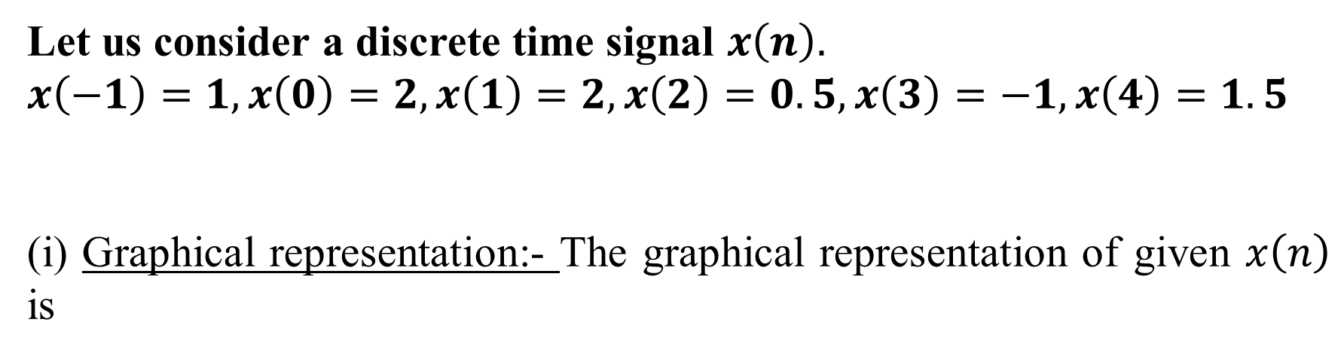
Representation of discrete-time signal (cont.)
Let us consider a discrete time signal $x\left(n\right).$
$$x\left(−1\right)=1, x\left(0\right)=2, x\left(1\right)=2, x\left(2\right)=0.5, x\left(3\right)=−1, x\left(4\right)=1.5$$
(i) Graphical representation:- The graphical representation of given $x\left(n\right)$ is
$$x(n)$$

Slide 31
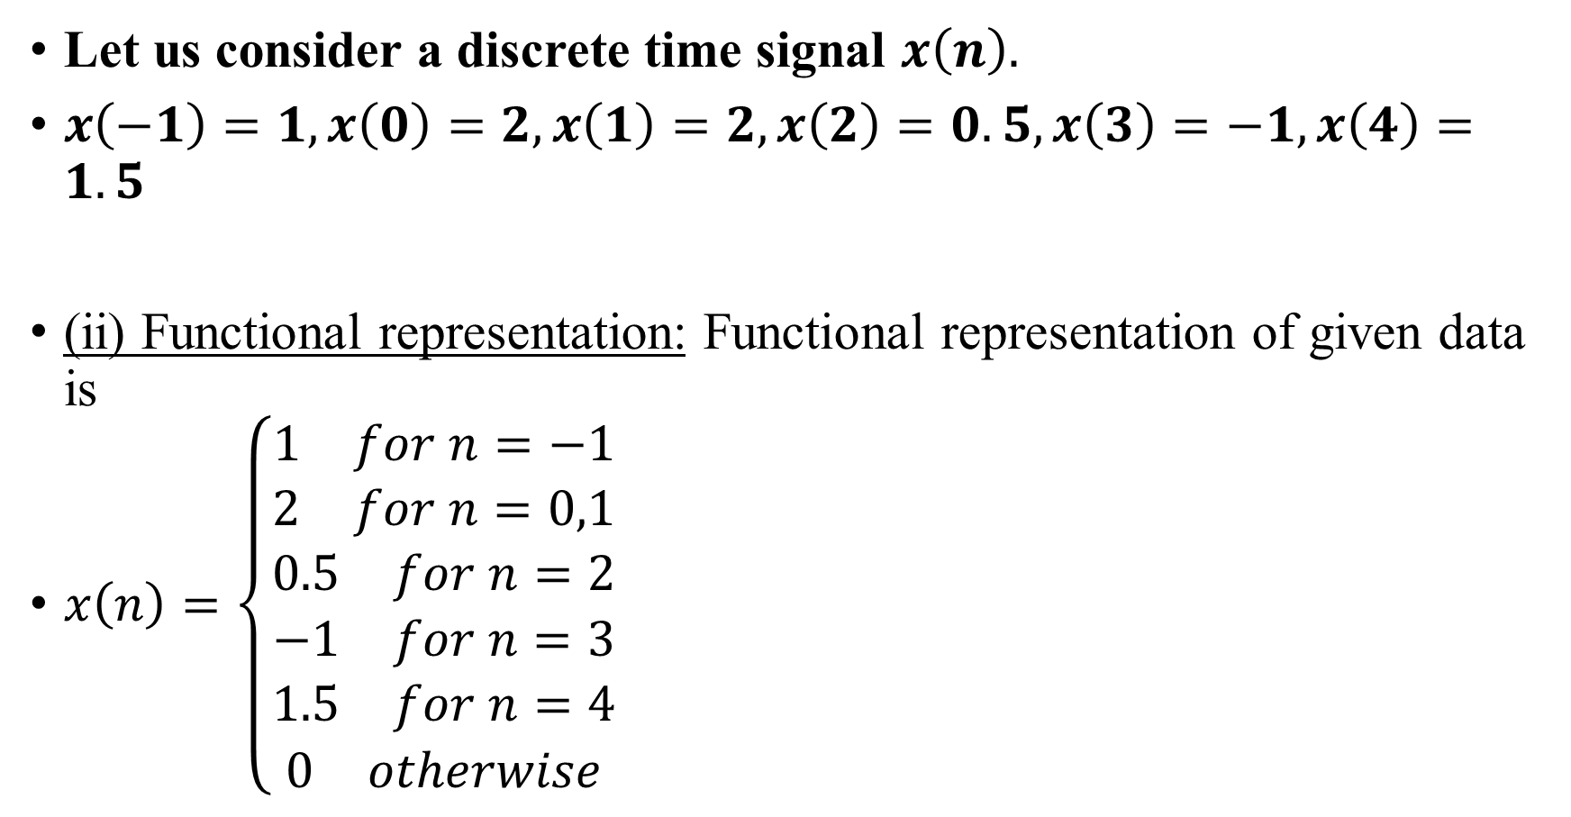
Representation of discrete-time signal (cont.)
Let us consider a discrete time signal $x\left(n\right).$
$x\left(−1\right)=1, x\left(0\right)=2, x\left(1\right)=2, x\left(2\right)=0.5, x\left(3\right)=−1, x\left(4\right)=1.5$
(ii) Functional representation: Functional representation of given data is
$x\left(n\right)=\left\{\begin{matrix}\begin{matrix}1 & for n=−1\end{matrix} \\ \begin{matrix}2 & for n=0,1\end{matrix} \\ \begin{matrix}\begin{matrix}0.5 & for n=2\end{matrix} \\ \begin{matrix}−1 & for n=3\end{matrix} \\ \begin{matrix}\begin{matrix}1.5 & for n=4\end{matrix} \\ \begin{matrix}0 & otherwise\end{matrix}\end{matrix}\end{matrix}\end{matrix}\right.$

Slide 32
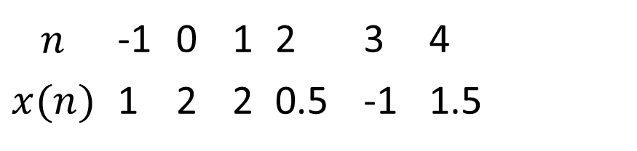
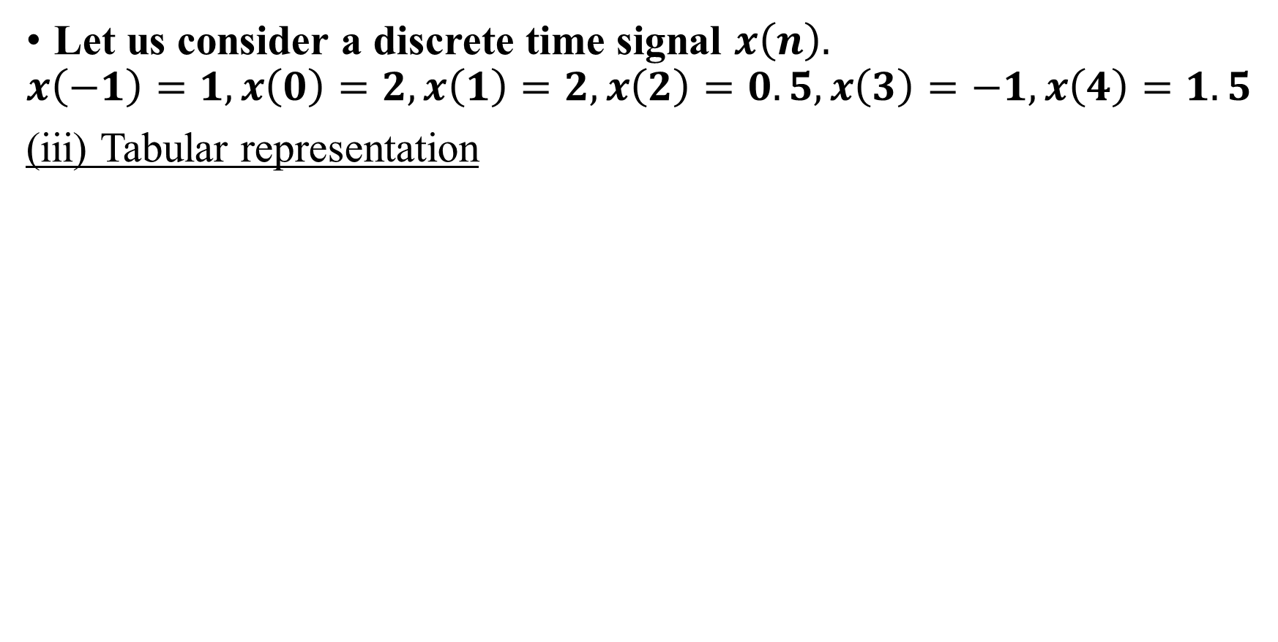
Representation of discrete-time signal (cont.)
Let us consider a discrete time signal $x\left(n\right).$
$$x\left(−1\right)=1, x\left(0\right)=2, x\left(1\right)=2, x\left(2\right)=0.5, x\left(3\right)=−1, x\left(4\right)=1.5$$
(iii) Tabular representation
$$n$$ | -1 | 0 | 1 | 2 | 3 | 4
$$x(n)$$ | 1 | 2 | 2 | 0.5 | -1 | 1.5

Slide 33
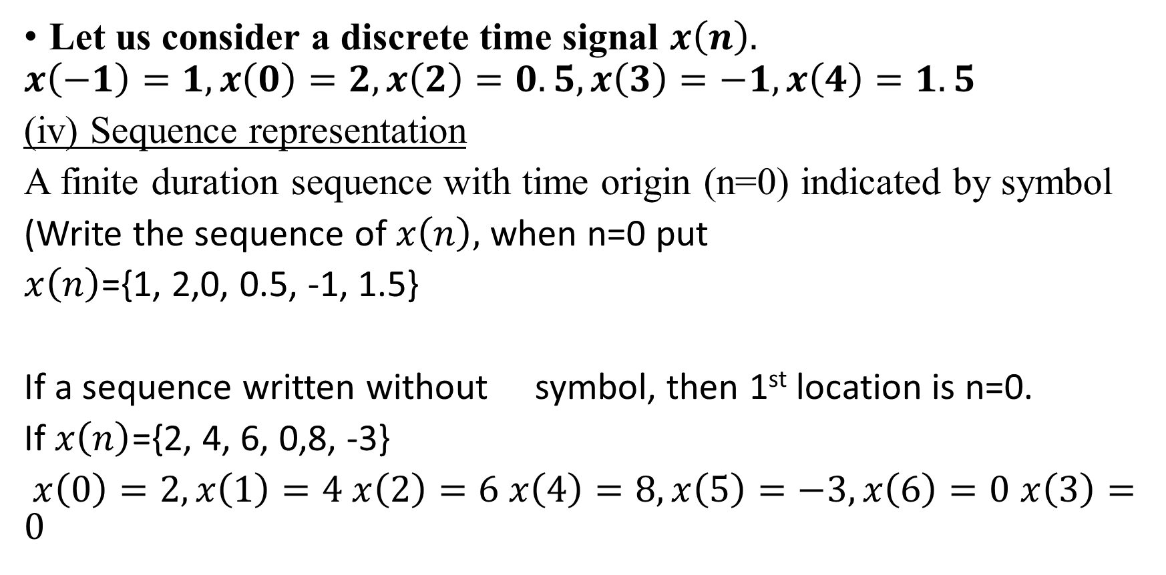
Representation of discrete-time signal (cont.)
Let us consider a discrete time signal $x\left(n\right).$
$$x\left(−1\right)=1, x\left(0\right)=2, x\left(2\right)=0.5, x\left(3\right)=−1, x\left(4\right)=1.5$$
(iv) Sequence representation
A finite duration sequence with time origin (n=0) indicated by symbol
(Write the sequence of $x\left(n\right),$when n=0 put
$x\left(n\right)$={1, 2,0, 0.5, -1, 1.5}
If a sequence written without symbol, then 1st location is n=0.
If $x\left(n\right)$={2, 4, 6, 0,8, -3}
$x\left(0\right)=2, x\left(1\right)=4 x\left(2\right)=6 x\left(4\right)=8, x\left(5\right)=−3, x\left(6\right)=0$ $x\left(3\right)=0$

Slide 34



Elementary discrete time signals
Unit step sequence:-
The unit step sequence is defined as
$$\begin{matrix}u\left(n\right)=1 & for n≥0 \\ =0 & for n<0\end{matrix}$$
$$n$$

Slide 35


Elementary discrete time signals (Cont.)
2. Unit ramp sequence:-
The unit ramp sequence is defined as
$$\begin{matrix}r\left(n\right)=n & for n≥0 \\ =0 & for n<0\end{matrix}$$

Slide 36


Elementary discrete time signals (Cont.)
3. Unit impulse sequence (unit sample sequence): Unit impulse sequence is defined as
$$\begin{matrix}δ(n)=1 & for n=0 \\ =0 & for n≠0\end{matrix}$$

Slide 37





Elementary discrete time signals (Cont.)
4. Exponential sequence
The exponential signal is a sequence of the form $x\left(n\right)=a^{n }$for all $n$

Slide 38


Elementary discrete time signals (Cont.)
5. Sinusoidal signal: The discrete time sinusoidal signal is given by
$$x\left(n\right)=Acos\left(w_{0}n+∅\right)$$
$∅=$phase differencre

Slide 39

Elementary discrete time signals (Cont.)
6. Complex exponential signal:-
The discrete time comlex exponential signal is given by
$x\left(n\right)=a^{n}e^{j\left(w_{0}n+∅\right)}$
For $\left|a\right|<1$→ The amplitude of the sinusoidal sequence decays exponentially.
For $\left|a\right|>1$→ the amplitude of sinusoidal sequence increases exponentially.

Slide 40

Problems:
Calculate the value of the followings:
Q. $\sum_{n=−∞}^{∞}{\begin{matrix}e^{2n} & δ(n−2)\end{matrix}}$
Ans:- As we know $\begin{matrix}δ(n)=1 & for n=0 \\ =0 & for n≠0\end{matrix}$
At $n$=2 or $n$-2=0, $δ(n−2)$=1,
for other value of $n$, $δ(n−2)$=0
So, $\sum_{−∞}^{∞}{\begin{matrix}e^{2n} & δ(n−2)\end{matrix}}$=${\left.e^{2n}\right|}_{n=2}$
=$e^{4}$

Slide 41

Problems (cont.)
2. Q. $\sum_{n=−∞}^{∞}{\begin{matrix}δ(n−1) & sin2n\end{matrix}}$
Ans:-At $n$=1 or $n$-1=0, $δ(n−1)$=1,
for other value of $n$, $δ(n−1)$=0
So, $\sum_{n=−∞}^{∞}{\begin{matrix}δ(n−1) & sin2n\end{matrix}}$
= ${\left.sin2n\right|}_{n=1}=$ $sin2$
3. Q. $\sum_{n=−∞}^{∞}{\begin{matrix}n^{2} & δ(n+2)\end{matrix}}$
Ans: At $n$=-2 or $n+2$=0, $δ(n+2)$=1,
for other value of $n$, $δ(n+2)$=0
$$\sum_{n=−∞}^{∞}{\begin{matrix}n^{2} & δ(n+2)\end{matrix}}$$
= ${\left.n^{2}\right|}_{n=−2}=4$

Slide 42

Problems (cont.)
4. Q. $\sum_{n=−∞}^{∞}{\begin{matrix}δ(n−1) & e^{n^{2}}\end{matrix}}$
Ans: At $n$=1 or $n$-1=0, $δ(n−1)$=1,
for other value of $n$, $δ(n−1)$=0
So, $\sum_{n=−∞}^{∞}{\begin{matrix}δ(n−1) & e^{n^{2}}\end{matrix}}$
=${\left.e^{n^{2}}\right|}_{n=1}$=e
5. Q. $\sum_{n=0}^{5}{\begin{matrix}δ(n+1) & 2^{n}\end{matrix}}$
Ans:- At $n$=-1 or $n+$1=0, $δ(n+1)$=1,
for other value of $n$, $δ(n−1)$=0
Here in summation starts n= -1 is not available, so result will be 0

Slide 43

Problems (cont.)
6Q $\sum_{n=2}^{∞}{\begin{matrix}δ(n−1) & sin2n\end{matrix}}$
Ans:- 0
7Q $\sum_{n=0}^{∞}{\begin{matrix}x(n) & δ(n−2)\end{matrix}}$
Ans: $x(2)$
8Q $\sum_{n=−∞}^{∞}{\begin{matrix}a^{n−2} & δ(n+3)\end{matrix}}$
Ans: $a^{−5}$

Slide 44
Basic operations on signal
The basic set of operations on a signal are:
1. Time shifting
2. Time reversal
3. Amplitude scaling
4. Time scaling
5. Signal addition
6. Signal multiplier

Slide 45





1.Time shifting
Let us consider a continuous time signal $x(t)$.
Time shifting of the signal may be delay or advance
Let $T$ is positive.
$x(t−T)$ delaying (right shift by $T$ unit).
$x(t+T)$ advancing (left shift by $T$ unit) .
E.g.1: $x\left(t\right)$ is shown in Fig. 1(a), calculate $x\left(t−2\right)$and $x\left(t+1\right)$
Tips:
Plot the signal do not put X axis. Then
$x(t−T)$ means add T unit to the X axis
Fig.1.(a)
Fig.1.(b)
Fig.1.(c)

Slide 46

1.Time shifting (cont.)
Similarly, for a discrete time signal $x\left(n\right)$
Let $k$ is positive.
$x(n−k)$ delaying (right shift by $k$ unit).
$x(n+k)$ advancing (left shift by $k$ unit).

Slide 47




1.Time shifting (cont.)
E.g. Given $x\left(−3\right)=4, x\left(−2\right)=−3, x\left(−1\right)=2, x\left(0\right)=1, x\left(1\right)=−1, x\left(2\right)=3, x\left(3\right)=4.$
Do the graphical representation of $x\left(n\right), x\left(n−2\right), x\left(n+3\right).$
Fig. 2.b
Fig. 2.a
Fig. 2.c

Slide 48





2. Time reversal (folding)
Time reversal of $x\left(t\right)$ can be obtained by folding the signal about t=0. It is denoted by $x\left(−t\right)$ as shown in Fig. 3.b.
Let $k$ is positive
$x(−t+k)$ delaying (right shift of $x\left(−t\right)$by $k$ unit)
$x(−t−k)$ advancing (left shift $x\left(−t\right)$by $k$ unit.
$x(t)$
$x(−t)$

Slide 49





2. Time reversal (cont.)
$x(−t)$
$x(−t−2)$
$x(−t+2)$

Slide 50

2. Time reversal (cont.)
Similarly, for a discrete time signal $x\left(n\right)$. Time reversal of $x\left(n\right)$ can be obtained by folding the signal about n=0. It is denoted by $x\left(−n\right)$
Let $k$ is positive
$x(−n+k)$ delaying (right shift of $x\left(−n\right)$by $k$ unit)
$x(−n−k)$ advancing (left shift $x\left(−n\right)$by $k$ unit)
E.g. Given $x\left(−3\right)=2,x\left(−2\right)=1,x\left(−1\right)=5, x\left(0\right)=−1, x\left(1\right)=−3, x\left(2\right)=4, x\left(3\right)=6, x\left(4\right)=2.$Do the graphical representation of $x\left(n\right), x\left(−n\right), x\left(−n+2\right), x\left(−n−3\right).$

Slide 51








2. Time reversal (cont.)
$$x(n)$$
$$x(−n)$$
$$x(−n+2)$$
$$x(−n−3)$$

Slide 52





3. Amplitude scaling (constant multiplication)
Amplitude scaling means multiply constant to whole signal.
$y\left(t\right)=3 x(t)$ is shown in figure.
$$x(t)$$
$$3x(t)$$

Slide 53






3.Amplitude scaling (cont.)
Similarly, the amplitude of discrete time signal can be represented
$y\left(n\right)=ax(n)$. Here, $a$is constant.
Eg. E.g. Given $x\left(0\right)=1, x\left(1\right)=2, x\left(2\right)=1$Do the graphical representation of $x\left(n\right), y\left(n\right), where y\left(n\right)=2x\left(n\right).$
$$y\left(n\right)=2x\left(n\right)$$
$$y\left(0\right)=2x\left(0\right)=2∗1=2$$
$$y\left(1\right)=2x\left(1\right)=2∗2=4$$
$$y\left(2\right)=2x\left(2\right)=2∗1=2$$
$$x(n)$$
$$2x(n)$$

Slide 54



4. Time scaling
In the time scaling, replace ‘’$t$’’ by ‘’$at$” in $x(t)$. for, $x(at+k)$, first perform $x(t+k)$, then perform time scaling. Similarly for $x(at−k)$, first perform $x(t−k)$, then perform time scaling.
(a)$y_{1}\left(t\right)=x\left(2t\right)$ (b) $y_{2}\left(t\right)=x\left(\frac{t}{2}\right)$ (c) $y_{3}\left(t\right)=x\left(\frac{t}{2}−3\right)$
(d) $y_{1}\left(t\right)=x\left(2t−3\right)$
$$x(t)$$

Slide 55







4. Time scaling (cont.)
$$y_{1}\left(t\right)=x\left(2t\right)$$
$$y_{1}\left(−0.5\right)=x\left(−1\right)=1$$
$$y_{1}\left(0\right)=x\left(0\right)=1$$
$$y_{1}\left(0.5\right)=x\left(1\right)=2$$
$$y_{1}\left(1.5\right)=x\left(3\right)=1$$
$$y_{1}\left(2\right)=x\left(4\right)=0$$
$$x(2t)$$
$$x(t)$$
$$y_{2}\left(t\right)=x \left(\frac{t}{2}\right)$$
$$y_{2}\left(−2\right)=x\left(−1\right)=1,y_{2}\left(−1\right)=x\left(−0.5\right)=1$$
$$y_{2}\left(0\right)=x\left(0\right)=1$$
$y_{2}\left(1\right)=x\left(0.5\right)$, $y_{2}\left(2\right)=x\left(1\right)=2$
$y_{2}\left(3\right)=x\left(1.5\right)$, $y_{2}\left(4\right)=x\left(2\right)=1$
$y_{2}\left(5\right)=x\left(2.5\right)$=1, $y_{2}\left(6\right)=x\left(3\right)=1$, $y_{2}\left(5\right)=x\left(3.5\right)$=0
$$x\left(\frac{t}{2}\right)$$

Slide 56






4. Time scaling (cont.)
$$x(t−3)$$
$$x(t/2−3)$$
$$x(2t−3)$$

Slide 57



4. Time scaling (cont.)
Similarly, for discrete time signal, In the time scaling, replace ‘’$n$’’ by ‘’$an$” in $x(n)$
E.g. Given $x\left(−3\right)=1, x\left(−2\right)=2, x\left(−1\right)=2, x\left(0\right)=4, x\left(1\right)=3, x\left(2\right)=2, x\left(3\right)=1.$Do the graphical representation of $y\left(n\right), where y\left(n\right)= x\left(2n\right).$
Answer:
$$y\left(n\right)=x\left(2n\right)$$
$$y\left(−2\right)=x\left(−4\right)=0$$
$$y\left(−1\right)=x\left(−2\right)=2$$
$$y\left(0\right)=x\left(0\right)=4$$
$$y\left(1\right)=x\left(2\right)=2$$
$$y\left(2\right)=x\left(4\right)=0$$

Slide 58




5. Signal addition
$y\left(t\right)=x_{1}\left(t\right)+x_{2}\left(t\right)$ where $x_{1}\left(t\right)$ and $x_{2}\left(t\right)$ are continuous time signal.
Similarly for discrete time signal
$y\left(n\right)=x_{1}\left(n\right)+x_{2}\left(n\right)$
The addition of 2 signals can be obtained by adding their values at every instant
For interval $0≤t≤1$
$$x_{1}\left(t\right)=1; x_{2}\left(t\right)=1$$
For interval $1≤t≤2$
$$x_{1}\left(t\right)=2; x_{2}\left(t\right)=0.5$$
For interval $2≤t≤3$
$$x_{1}\left(t\right)=1; x_{2}\left(t\right)=1.5$$

Slide 59




5. Signal addition (Cont.)
$y\left(t\right)=$ $x_{1}\left(t\right)$+ $x_{2}\left(t\right)$
For interval $0≤t≤1$
$$y\left(t\right)=1+1=2$$
For interval $1≤t≤2$
$$y\left(t\right)=2+0.5=2.5$$
For interval $2≤t≤3$
$$y\left(t\right)=1+1.5=2.5$$
$y\left(t\right)=$ $x_{1}\left(t\right)−$ $x_{2}\left(t\right)$
For interval $0≤t≤1$
$$y\left(t\right)=1−1=0$$
For interval $1≤t≤2$
$$y\left(t\right)=2−0.5=1.5$$
For interval $2≤t≤3$
$$y\left(t\right)=1−1.5=−0.5$$

Slide 60


5. Signal addition (Cont.)
$$x_{2}\left(n\right)=\left\{1,−2,3,2\right\}$$
E.g. $x_{1}\left(n\right)=\left\{1,3,2,1\right\}$
$y_{1}\left(n\right)=$ $x_{1}\left(n\right)+$ $x_{2}\left(n\right)$
$y_{2}\left(n\right)=$ $x_{1}\left(n\right)−$ $x_{2}\left(n\right)$
$$y_{1}\left(n\right)=\left\{0+1, 0−2, 1+3, 3+2, 2+0, 1+0\right\}$$
$$y_{1}\left(n\right)=\left\{1, −2, 4, 5, 2, 1\right\}$$
$$y_{2}\left(n\right)=\left\{0−1, 0+2, 1−3, 3−2, 2−0, 1−0\right\}$$
$$y_{2}\left(n\right)=\left\{−1, 2, −2, 1, 2, 1\right\}$$

Slide 61




6. Signal multiplication
The multiplication of 2 signals can be obtained by multiplying their values at every instant.
For interval $0≤t≤1$
$$x_{1}\left(t\right)=t; x_{2}\left(t\right)=1$$
For interval $1≤t≤2$
$$x_{1}\left(t\right)=1; x_{2}\left(t\right)=0.5$$
For interval $2≤t≤3$
$$x_{1}\left(t\right)=0.5; x_{2}\left(t\right)=1.5$$
$y\left(t\right)=$ $x_{1}\left(t\right).x_{2}\left(t\right)$
For interval $0≤t≤1 y\left(t\right)=t∗1=t$
For interval $1≤t≤2 y\left(t\right)=1∗0.5=0.5$
For interval $2≤t≤3 y\left(t\right)=0.5∗1.5=0.75$

Slide 62



6. Signal multiplication (cont.)
$$x_{2}\left(n\right)=\left\{−1,1,0.5,0.5,1\right\}$$
E.g. $x_{1}\left(n\right)=\left\{1,2,−2,3,2\right\}$
$y\left(n\right)=$ $x_{1}\left(n\right)∗$ $x_{2}\left(n\right)$
$$y\left(n\right)=\left\{0∗−1, 1∗1, 2∗0.5,−2∗0.5, 3∗1,2∗0\right\}$$
$$y\left(n\right)=\left\{0,1,1,−1,3,0\right\}$$

Slide 63








Problems:
Sketch the followings:
$u(−t+1)$
$2. 3r(t−1)$

Slide 64








3. $π\left(t−\frac{1}{2}\right)+π\left(t−1\right)$
4. $u\left(n+2\right)−u(n−3)$

Slide 65




5. $u\left(−n+2\right)u(n)$

Slide 66
Classification of Signals
The signals are classified according to their characteristic.
Continuous time and discrete time signal
Deterministic and random signals
Periodic and aperiodic signals
Even and odd signals
Energy and power signals

Slide 67

2. Deterministic and Random Signals
Deterministic signal:
A deterministic signal is a signal exhibiting no uncertainty of value at any given instant of time
Its instantaneous value can be predicted by mathematical equation
For example x(t) = sin(3t) is deterministic signal.

Slide 68

2. Deterministic and Random Signals (cont.)
Random signal:
A random signal is characterized by uncertainty before its actual occurrence.
Behavior of these signals are random i.e. not predictable with respect to time.
These signals can’t be expressed mathematically.
For example Thermal Noise generated is non deterministic signal.

Slide 69
3. Periodic and aperiodic signals
A continuous time signal $x(t)$ is said to be periodic if it satisfies the condition
$x\left(t+T\right)=x(t)$ for all t. Otherwise aperiodic
The smallest value of T that satisfies the above condition is known as fundamental period.
A discrete time signal $x(n)$ is said to be periodic if it satisfies the condition
$x\left(n+N\right)=x(n)$ for all n. Otherwise aperiodic
The smallest value of N that satisfies the above condition is known as fundamental period.

Slide 70

3. Periodic and aperiodic signals (cont.)
The above sequence is repeating after every 4 samples. So, fundamental period=4.

Slide 71
3. Periodic and aperiodic signals (cont.)
For Sinusoidal signal
Let $x\left(t\right)=Asin\left(Ω_{0}t+θ\right)$----------------(1)
For periodic signal $x\left(t+T\right)=x(t)$
$x\left(t+T\right)=$ $Asin\left(Ω_{0}(t+T)+θ\right)$
= $Asin\left(Ω_{0}t+Ω_{0}T+θ\right)$-----------------------(2)
Equation (1) and (2) are equal if
$Ω_{0}T$=$2π$,
so $T=\frac{2π}{Ω_{0}}$
$T=$fundamental period or time period
$Ω_{0}$=Fundamental frequency

Slide 72
3. Periodic and aperiodic signals (cont.)
For complex exponential signal
Let $x\left(t\right)=e^{jΩ_{0}t}$
For periodic signal $x\left(t+T\right)=x(t)$
$x\left(t+T\right)=e^{jΩ_{0}(t+T)}=$ $e^{jΩ_{0}t}$ $e^{jΩ_{0}T}$= $e^{jΩ_{0}t}(cosΩ_{0}T+jsin$ $Ω_{0}T$)
As for periodic $x\left(t+T\right)=x(t)$
$(cosΩ_{0}T+jsin$ $Ω_{0}T$)=1, If $Ω_{0}T$=2π, $(cosΩ_{0}T+jsin$ $Ω_{0}T$)=1
So for periodic
$T=\frac{2π}{Ω_{0}}$ $T=$fundamental period or time period
$Ω_{0}$=Fundamental frequency

Slide 73
Condition for sum of 2 periodic signal to be periodic
The sum of 2 periodic signal $x_{1}(t)$ and $x_{2}(t)$ with periods $T_{1}$ and $T_{2}$ may or may not be periodic depending on the relation between $T_{1}$ and $T_{2}$.
If the sum to be periodic, the ratio of periods $\frac{T_{1}}{T_{2}}$ must be rational number or ratio of 2 integers. Otherwise sum is not periodic.
If, $\frac{T_{1}}{T_{2}}$=$\frac{a}{b}$
Fundamental time period=$T=$ $bT_{1}$

Slide 74
Problem
Find the fundamental period T of the following continuous-time signal, if, they are periodic.
Q. $x\left(t\right)=je^{j5t}$
Ans:- Given $x\left(t\right)=je^{j5t}$ . The signal is periodic.
$T=\frac{2π}{Ω_{0}}$ Here $Ω_{0}$=5.
$T=\frac{2π}{5}$=0.4π second.
2. Q. $x\left(t\right)=sin⁡($50$πt)$
Ans:- $T=\frac{2π}{Ω_{0}}$ Here $Ω_{0}$=50 $π$. The signal is periodic
$T=\frac{2π}{50π}$= $\frac{1}{25}$

Slide 75
Problem (Cont.)
3 Q. $x\left(t\right)=20cos⁡(10πt+\frac{π}{6})$
Ans:- $T=\frac{2π}{Ω_{0}}$ Here $Ω_{0}$= 10$π$. The signal is periodic
$T=\frac{2π}{\text{10}π}$= $\frac{1}{5}$ second
4 Q. $x\left(t\right)=4cos⁡(5πt)$
$T=\frac{2π}{Ω_{0}}$ Here $Ω_{0}$= 5$π$. The signal is periodic
$T=\frac{2π}{\text{5}π}$= $\frac{2}{5}$ second
5. Q. $x\left(t\right)=sin⁡($50$πt)$u(t)
Ans:- $x\left(t+T\right)=sin⁡($50$π(t+T))$u(t+T).
As u(t)≠u(t+T) The signal is aperiodic.

Slide 76
Problem (Cont.)
6.Q. $x\left(t\right)=e^{−\left|t\right|}$
Ans:- $x\left(t+T\right)=e^{−\left|t+T\right|}$
As $x\left(t\right)≠$ $x\left(t+T\right)$.
So the $x\left(t\right)=e^{−\left|t\right|}$ is aperiodic

Slide 77
Problem (Cont.)
Find whether the following signals are periodic or not. Also, find the fundamental time period T.
1 Q. $x\left(t\right)=2\cos\left(10t+1\right)−\sin\left(4t−1\right)$
Ans:-$T_{1}=\frac{2π}{Ω_{0}}$ Here $Ω_{0}$= 10, So $T_{1}=\frac{2π}{10}$= $\frac{π}{5}$
$T_{2}=\frac{2π}{Ω_{0}}$ Here $Ω_{0}$= 4, So $T_{2}=\frac{2π}{4}$= $\frac{π}{2}$
So, $\frac{T_{1}}{T_{2}}$=$\frac{\frac{π}{5}}{\frac{π}{2} }$= $\frac{2}{5}$
As the ratio is rational number so the sum of 2 signals are periodic.
Fundamental period=T= ${5T}_{1}=2T_{2}=$5 $\frac{π}{5}$= $π$ sec.

Slide 78
Problem (Cont.)
2. Q. $x\left(t\right)=\cos\left(60πt\right)−\sin\left(50πt\right)$
Ans:-$T_{1}=\frac{2π}{Ω_{0}}$ Here $Ω_{0}$= 60 $π$, So $T_{1}=\frac{2π}{\text{60} π}$= $\frac{1}{30}$
$T_{2}=\frac{2π}{Ω_{0}}$ Here $Ω_{0}$= 50 $π$, So $T_{2}=\frac{2π}{50π}$= $\frac{1}{25}$
So, $\frac{T_{1}}{T_{2}}$=$\frac{\frac{1}{30}}{\frac{1}{25}}$= $\frac{5}{6}$
As the ratio is rational number so the sum of 2 signals are periodic.
Fundamental period=T= ${6T}_{1}=5T_{2}=$6$\frac{1}{30}$=$\frac{1}{5}sec$

Slide 79
Problem (Cont.)
3. Q. $x\left(t\right)=2u\left(t\right)+2\sin\left(2t\right)$
Ans:- $u\left(t\right)$ is aperiodic, so total sum will be aperiodic
4. Q. $x\left(t\right)=3cos\left(4t\right)+2\sin\left(2πt\right)$
Ans:-$T_{1}=\frac{2π}{Ω_{0}}$ Here $Ω_{0}$= 4, So $T_{1}=\frac{2π}{\text{4}}$= $\frac{π}{2}$
$T_{2}=\frac{2π}{Ω_{0}}$ Here $Ω_{0}$= $2π$, So $T_{2}=\frac{2π}{2π}$=1
So, $\frac{T_{1}}{T_{2}}$=$\frac{\frac{π}{2}}{1}$= $\frac{π}{2}$
As the ratio is not rational number so the sum of 2 signals are aperiodic.

Slide 80


Problem (Cont.)
5. Q. $x\left(t\right)=u\left(t\right)−\frac{1}{2}$
Ans:- The signal is aperiodic, because it can not be repeated.

Slide 81
Problem (Cont.)
6. Q. $x\left(t\right)=\sin^{2}(t)$
Ans:-$\sin^{2}(t)$=$\frac{1−cos⁡(2t)}{2}$
$T=\frac{2π}{Ω_{0}}$ Here $Ω_{0}$=2. $T=\frac{2π}{2}$=π second.
The signal is periodic

Slide 82
Condition for discrete time signal to be periodic
A discrete time signal $x(n)$ is said to be periodic if it satisfies the condition
$x\left(n+N\right)=x(n)$ for all n. Otherwise aperiodic
The smallest value of N that satisfies the above condition is known as fundamental period.
Let $x\left(n\right)=Asin\left(w_{0}n+θ\right)$----------------(1)
For periodic signal $x\left(n+N\right)=x(n)$
$x\left(n+N\right)=$ $Asin\left(w_{0}(n+N)+θ\right)$
= $Asin\left(w_{0}n+w_{0}N+θ\right)$-----------------------(2)
Equation (1) and (2) are equal for periodic if
$w_{0}N$=$2πm$, so $N=\frac{2πm}{w_{0}} m$ is a value so that N is integer
$N=$fundamental period or time period
$w_{0}$=Fundamental frequency

Slide 83
Problems
Find the whether the following are periodic or not. If periodic, find the fundamental period.
Q. $x\left(n\right)=\cos\left(0.1πn\right)$
Ans:- $N=\frac{2πm}{w_{0}}$, Here $w_{0}$= $0.1π$,
So N= $\frac{2πm}{0.1π}$=20m.
To convert N as integer minimum value of m=1
Fundamental period=N=20. signal is periodic

Slide 84
Problems (Cont.)
2. Q. $x\left(n\right)=e^{j6πn}$
Ans:- $N=\frac{2πm}{w_{0}}$, Here $w_{0}$= $6π$,
So N= $\frac{2πm}{6π}$= $\frac{m}{3}$.
To convert N as integer minimum value of m=3
Fundamental period=N=1. signal is periodic
3. Q. $x\left(n\right)=\sin\left(\frac{6πn}{7}+1\right)$
Ans:- $N=\frac{2πm}{w_{0}}$, Here $w_{0}$=$\frac{6π}{7}$,
So N= $\frac{2πm}{\frac{6π}{7}}$=$\frac{7m}{3}$.
To convert N as integer minimum value of m=3
Fundamental period=N=7. signal is periodic

Slide 85
Problems (cont.)
4. Q. $x\left(n\right)=e^{j\frac{2π}{3}n}$+ $e^{j\frac{3π}{4}n}$
Ans:- $N_{1}=\frac{2πm}{w_{0}}$, Here $w_{0}$=$\frac{2π}{3}$,
So $N_{1}$= $\frac{2πm}{\frac{2π}{3}}$=3m.
To convert $N_{1}$ as integer minimum value of m=1 $N_{1}$=3.
$N_{2}=\frac{2πm}{w_{0}}$, Here $w_{0}$=$\frac{3π}{4}$,
So $N_{2}$= $\frac{2πm}{\frac{3π}{4}}$=$\frac{8m}{3}$.
To convert $N_{2}$ as integer minimum value of m=3 $N_{2}$=8.
$N=\frac{N_{1}}{N_{2}}$=$\frac{3}{8}$ so $N=$8 $N_{1}$= 8 $N_{2}$=24 signal is periodic

Slide 86
Problems (cont.)
5. Q. $x\left(n\right)=\frac{3}{5}e^{j3π(n+\frac{1}{2})}$
Ans:- $N=\frac{2πm}{w_{0}}$, Here $w_{0}$= $3π$,
So N= $\frac{2πm}{3π}$= $\frac{2m}{3}$.
To convert N as integer minimum value of m=3
Fundamental period=N=2. signal is periodic
6. Q. $x\left(n\right)=12\cos{(20n)}$
Ans:- $N=\frac{2πm}{w_{0}}$, Here $w_{0}$= $20$,
So N= $\frac{2πm}{20}$= $\frac{πm}{10}$.
To convert N as integer minimum value of m as a integer can not be determined. So, signal is aperiodic

Slide 87
Problems (cont.)
7. Q. $x\left(n\right)=\cos\left(\frac{1}{4}n\right)$
Ans:- $N=\frac{2πm}{w_{0}}$, Here $w_{0}$=$\frac{1}{4}$,
So N= $\frac{2πm}{\frac{1}{4}}$=$8πm$.
To convert N as integer minimum value of m as a integer can not be determined. So, signal is aperiodic

Slide 88
4. Symmetric (even) and anti-symmetric (odd) signal
Symmetric (even) signal
A continuous time signal $x(t)$ is said to be symmetric (even) signal if it satisfies the condition $x\left(−t\right)=$ $x\left(t\right)$ for all t
A discrete time signal $x(n)$ is said to be symmetric (even) signal if it satisfies the condition $x\left(−n\right)=$ $x\left(n\right)$ for all $n$.
Anti-symmetric (odd) signal
A continuous time signal $x(t)$ is said to be anti-symmetric (odd) signal if it satisfies the condition $x\left(−t\right)=$ $−x\left(t\right)$ for all t
A discrete time signal $x(n)$ is said to be anti-symmetric (odd) signal if it satisfies the condition $x\left(−n\right)=−x\left(n\right)$ for all $n$.

Slide 89
Even and odd part of signal
Even part of signal
Even part of continuous time signal $x(t)$=$x_{e}\left(t\right)=\frac{x(t)\text{+}x(−t)}{2}$
Even part of discrete time signal $x(n)$=$x_{e}\left(n\right)=\frac{x(n)\text{+}x(−n)}{2}$
Odd part of signal
Odd part of continuous time signal $x(t)$=$x_{o}\left(t\right)=\frac{x(t)\text{−}x(−t)}{2}$
Odd part of discrete time signal $x(n)$=$x_{o}\left(n\right)=\frac{x(n)\text{−}x(−n)}{2}$

Slide 90
Problems
Identify the following signals are even or odd.
Q. $x\left(t\right)=cost$
Ans:- $x\left(−t\right)=\cos\left(−t\right)$
$$=cost$$
As $x\left(−t\right)=$ $x\left(t\right)$.
So $x\left(t\right)=cost$ is even signal.
2. Q. $x\left(t\right)=cost sint$
Ans:- $x\left(−t\right)=\cos\left(−t\right)\sin\left(−t\right)$
=$cost (−sint)$=$−costsint$
As $x\left(−t\right)=$ $−x\left(t\right)$.
So, $x\left(t\right)=costsint$ is odd signal.

Slide 91
Problems
Find the even and odd components of the following signals
Q. $x\left(t\right)=cost+sint+cost sint$
Ans:- Even part of continuous time signal $x(t)$=$x_{e}\left(t\right)=\frac{x(t)\text{+}x(−t)}{2}$
$x(−t)$= $\cos\left(−t\right)+\sin\left(−t\right)+\cos\left(−t\right)\sin\left(−t\right)$
= $cost−sint−cost sint$
$x_{e}\left(t\right)=\frac{x(t)\text{+}x(−t)}{2}$ = $\frac{cost+sint+cost sint\text{+ }cost−sint−cost sint }{2}$ =$\frac{2cost }{2}$ = $cost$
Odd part of continuous time signal $x(t)$=$x_{o}\left(t\right)=\frac{x(t)\text{−}x(−t)}{2}$
$x_{o}\left(t\right)=\frac{x(t)\text{−}x(−t)}{2}$ = $\frac{cost+sint+cost sint\text{− }cost+sint+cost sint }{2}$ =$\frac{2sint+2cost sint}{2}$ =$sint+cost sint$

Slide 92
Problems (cont. )
2. Q. $x\left(n\right)=\left\{−2, 1, 2, −1, 3\right\}$
Ans:- $x\left(−n\right)=\left\{3, −1, 2, 1, −2\right\}$
Even part of discrete time signal $x(n)$=$x_{e}\left(n\right)=\frac{x(n)\text{+}x(−n)}{2}$
$x_{e}\left(n\right)=\frac{1}{2}$ $\left\{−2+3, 1−1, 2+2, −1+1, 3−2\right\}$= $\frac{1}{2}$ $\left\{1, 0, 4, 0, 1\right\}$
= $\left\{0.5, 0, 2, 0, 0.5\right\}$
Odd part of discrete time signal $x(n)$=$x_{o}\left(n\right)=\frac{x(n)\text{−}x(−n)}{2}$
$x_{o}\left(n\right)=\frac{1}{2}$ $\left\{−2−3, 1+1, 2−2, −1−1, 3+2\right\}$= $\frac{1}{2}$ $\left\{−5, 2, 0, −2, 5\right\}$
= $\left\{−2.5, 1, 0, −1, 2.5\right\}$

Slide 93
Problems (cont. )
3. Q. $x\left(t\right)=sint+2sint+2\sin^{2}\left(t\right) cost$
Ans:- $x\left(−t\right)=sin⁡(−t)+2sin⁡(−t)+2\sin^{2}\left(−t\right) cos⁡(−t)$
=$−sint−2sint+2\sin^{2}\left(t\right) cost$
Even part of continuous time signal $x(t)$=$x_{e}\left(t\right)=\frac{x(t)\text{+}x(−t)}{2}$
$x_{e}\left(t\right)=\frac{x(t)\text{+}x(−t)}{2}$ = $\frac{sint+2sint+2\sin^{2}\left(t\right) cost−sint−2sint+2\sin^{2}\left(t\right) cost}{2}$
=$\frac{4\sin^{2}\left(t\right) cost}{2}$ = $2\sin^{2}\left(t\right) cost$
Odd part of continuous time signal $x(t)$=$x_{o}\left(t\right)=\frac{x(t)\text{−}x(−t)}{2}$
$x_{o}\left(t\right)=\frac{x(t)\text{−}x(−t)}{2}$ = $\frac{sint+2sint+2\sin^{2}\left(t\right) cost+sint+2sint−2\sin^{2}\left(t\right) cost}{2}$ =$\frac{2sint+4sint}{2}$ =$sint+2sint$

Slide 94
Problems (cont. )
4. Q. $x\left(n\right)=\left\{1, 0, −1, 2, 3\right\}$
Ans:- $x\left(−n\right)=y\left(n\right)=\left\{3, 2, −1, 0, 1\right\}$
Even part of discrete time signal $x(n)$=$x_{e}\left(n\right)=\frac{x(n)\text{+}x(−n)}{2}$
$x_{e}\left(n\right)=\frac{1}{2}$ $\left\{3, 2,−1,0,1+1,0,−1,2,3\right\}$= $\frac{1}{2}\left\{3, 2,−1,0,2,0,−1,2,3\right\}$
=$\left\{1.5, 1,−0.5,0,1,0,−0.5,1,1.5\right\}$
Odd part of discrete time signal $x(n)$=$x_{o}\left(n\right)=\frac{x(n)\text{−}x(−n)}{2}$
$x_{e}\left(n\right)=\frac{1}{2}\left\{−3, −2,1,0,1−1,0,−1,2,3\right\}$= $\frac{1}{2}\left\{−3, −2,1,0,0,0,−1,2,3\right\}$
=$\left\{−1.5, −1,0.5,0,0,0,−0.5,1,1.5\right\}$

Slide 95

5. Energy and power signal
Energy and average power of any signal is defined as:
$$\lim_{T→∞}{\int_{−T}^{T}{\begin{matrix}{\left|x(t)\right|}^{2} & dt\end{matrix}}}$$
$$\sum_{n=−∞}^{∞}{{\left|\left.x(n\right)\right|}^{2}}$$
=$\int_{−∞}^{∞}{{\left|\left.x(t\right)\right|}^{2}dt}$
RMS value of the signal $x\left(t\right)=\sqrt{P}$

Slide 96

5. Energy and power signal (cont.)
A signal $\left.x(t\right)$ is called an energy signal if the energy satisfies 0 < E < ∞. For an energy signal P = 0.
A signal $\left.x(t\right)$ is called a power signal if the power satisfies 0 < P < ∞. For a power signal E = ∞.
If either of conditions are not satisfied, the signal is neither energy nor power signal.

Slide 97
Some Formulas of math
$$\cos^{2}A=\frac{1+\cos{2A}}{2} \sin^{2}A=\frac{1−\cos{2A}}{2}$$
$\left|e^{jθ}\right|$=1
$$\sum_{n=0}^{∞}{a^{n}=\frac{1}{1−a}}$$
$$\sum_{n=0}^{N}{a^{n}=\frac{1−a^{N+1}}{1−a}}$$

Slide 98
Problems
Find which of the signals are energy signals, power signals, neither energy or nor power signals.
Q. $x\left(t\right)=e^{−3t}u(t)$
Ans:-$E=\lim_{T→∞}{\int_{−T}^{T}{\begin{matrix}{\left|x(t)\right|}^{2} & dt\end{matrix}}}$ = $\lim_{T→∞}{\int_{−T}^{T}{\begin{matrix}{\left|e^{−3t}u(t) \right|}^{2} & dt\end{matrix}}}$
As $\begin{matrix}u\left(t\right)=1 & for t≥0 \\ =0 & for t<0\end{matrix}$ So, $E=\lim_{T→∞}{\int_{0}^{T}{\begin{matrix}{\left|e^{−3t} \right|}^{2} & dt\end{matrix}}}$
$E=\lim_{T→∞}{\int_{0}^{T}{\begin{matrix}e^{−6t} & dt \end{matrix}}}$=$\lim_{T→∞}{\left.\frac{e^{−6t}}{−6}\right|}_{0}^{T}$=${\left.\frac{e^{−6t}}{−6}\right|}_{t=0}^{∞}$=0$−\frac{1}{−6}$=$\frac{1}{6}$ E= $\frac{1}{6}$
$P=\lim_{T→∞}{\frac{1}{2T}\int_{−T}^{T}{\begin{matrix}{\left|x(t)\right|}^{2} & dt\end{matrix}}}$ = $\lim_{T→∞}\frac{1}{2T}{\int_{−T}^{T}{\begin{matrix}{\left|e^{−3t}u(t) \right|}^{2} & dt\end{matrix}}}$
$P=\lim_{T→∞}\frac{1}{2T}{\int_{0}^{T}{\begin{matrix}{\left|e^{−3t} \right|}^{2} & dt\end{matrix}}}$ = $\lim_{T→∞}{\frac{1}{2T}\int_{0}^{T}{\begin{matrix}e^{−6t} & dt \end{matrix}}}$=$\lim_{T→∞}\frac{1}{2T}{\left.\frac{e^{−6t}}{−6}\right|}_{t=0}^{T}$
= $\lim_{T→∞}\frac{1}{2T}\frac{e^{−6T}−1}{−6}$ =0, P=0 E= finite and P=0 So it is a energy signal.

Slide 99
Problems (Cont.)
2. Q. $x\left(t\right)=e^{j(2t+\frac{π}{4})}$
Ans:- $E=\lim_{T→∞}{\int_{−T}^{T}{\begin{matrix}{\left|x(t)\right|}^{2} & dt\end{matrix}}}$ = $\lim_{T→∞}{\int_{−T}^{T}{\begin{matrix}{\left|e^{j(2t+\frac{π}{4})}\right|}^{2} & dt\end{matrix}}}$
As, $\left|e^{jθ}\right|$=1, So, $E=\lim_{T→∞}{\int_{−T}^{T}{\begin{matrix}1 & dt\end{matrix}}}$ = $\lim_{T→∞}$ ${\left.t\right|}_{t=−T}^{T}$=$\lim_{T→∞}2T$
E=∞
$P=\lim_{T→∞}{\frac{1}{2T}\int_{−T}^{T}{\begin{matrix}{\left|x(t)\right|}^{2} & dt\end{matrix}}}$= $\lim_{T→∞}{\frac{1}{2T}\int_{−T}^{T}{\begin{matrix}{\left|e^{j(2t+\frac{π}{4})}\right|}^{2} & dt\end{matrix}}}$
= $\lim_{T→∞}{\frac{1}{2T}\int_{−T}^{T}{\begin{matrix}1 & dt\end{matrix}}}$= $\lim_{T→∞}\frac{2T}{2T}$=1
As P finite and E infinite so it is a power signal

Slide 100
Problems (Cont.)
3. Q. $x\left(t\right)=cost$
Ans:- $E=\lim_{T→∞}{\int_{−T}^{T}{\begin{matrix}{\left|x(t)\right|}^{2} & dt\end{matrix}}}$= $\lim_{T→∞}{\int_{−T}^{T}{\begin{matrix}\cos^{2}(t) & dt\end{matrix}}}$ = $\lim_{T→∞}{\int_{−T}^{T}{\begin{matrix}\frac{1}{2} (1+cos2t) & dt\end{matrix}}}$ =∞
$P=\lim_{T→∞}{\frac{1}{2T}\int_{−T}^{T}{\begin{matrix}{\left|x(t)\right|}^{2} & dt\end{matrix}}}$= $\lim_{T→∞}\frac{1}{2T}{\int_{−T}^{T}{\begin{matrix}\cos^{2}(t) & dt\end{matrix}}}$=
$\lim_{T→∞}{\frac{1}{2T}\int_{−T}^{T}{\begin{matrix}\frac{1}{2} (1+cos2t) & dt\end{matrix}}}$=$\frac{1}{2}$
As P finite and E infinite so it is a power signal

Slide 101
Problems (Cont.)
4. Q. $x\left(n\right)={\left(\frac{1}{3}\right)}^{n}u\left(n\right)$
Ans:- E= $\sum_{n=−∞}^{∞}{{\left|\left.x(n\right)\right|}^{2}}$=$\sum_{n=−∞}^{∞}{{\left|{\left(\frac{1}{3}\right)}^{n}u\left(n\right)\right|}^{2}}$
$\begin{matrix}u\left(n\right)=1 & for n≥0 \\ =0 & for n<0\end{matrix}$So E=$\sum_{n=0}^{∞}{{\left|{\left(\frac{1}{3}\right)}^{n}\right|}^{2}}$=$\sum_{n=0}^{∞}{{\frac{1}{9}}^{n}}$
$\sum_{n=0}^{∞}{a^{n}=\frac{1}{1−a}}$ So E=$\frac{1}{1−\frac{1}{9}}$=$\frac{9}{8}$
P= $\lim_{N→∞} \frac{1}{2N+1}\sum_{n=−N}^{N}{{\left|\left.x(n\right)\right|}^{2}}$= $\lim_{N→∞}\frac{1}{2N+1}\sum_{n=−N}^{N}{{\left|{\left(\frac{1}{3}\right)}^{n}u\left(n\right)\right|}^{2}}$=
$\lim_{N→∞}\frac{1}{2N+1}\sum_{n=0}^{N}{{\left|{\left(\frac{1}{3}\right)}^{n}\right|}^{2}}$ = $\lim_{N→∞}\frac{1}{2N+1}\sum_{n=0}^{N}{{\frac{1}{9}}^{n}}$
$\sum_{n=0}^{N}{a^{n}=\frac{1−a^{N+1}}{1−a}}$, So P= $\lim_{N→∞}$ $\frac{1}{2N+1}$ $\frac{1−{\frac{1}{9}}^{N+1}}{1−\frac{1}{9}}$=0 As E is finite and p is zero so energy signal

Slide 102

Problems (Cont.)
5.Q. $x\left(n\right)=e^{j\left(\frac{π}{2}n+\frac{π}{8}\right)}$
Ans:- $x\left(n\right)=e^{j\left(\frac{π}{2}n+\frac{π}{8}\right)}$
E= $\sum_{n=−∞}^{∞}{{\left|\left.x(n\right)\right|}^{2}}$
= $\sum_{n=−∞}^{∞}{{\left|e^{j\left(\frac{π}{2}n+\frac{π}{8}\right)}\right|}^{2}}$
= $\sum_{n=−∞}^{∞}{1}$=∞
P= $\lim_{N→∞} \frac{1}{2N+1}\sum_{n=−N}^{N}{{\left|\left.x(n\right)\right|}^{2}}$
= $\lim_{N→∞}\frac{1}{2N+1}\sum_{n=−N}^{N}{{\left|e^{j\left(\frac{π}{2}n+\frac{π}{8}\right)}\right|}^{2}}$
=$\lim_{N→∞}\frac{1}{2N+1}\sum_{n=0}^{N}{(2N+1)}$ = $1$
Power is finite. So the signal is power signal.

Slide 103


Problems (Cont.)
$$\cos^{2}A=\frac{1+\cos{2A}}{2}$$
6. Q. $x\left(n\right)=cos\left(\frac{π}{4}n\right)$
Ans:-E= $\sum_{n=−∞}^{∞}{{\left|\left.x(n\right)\right|}^{2}}$
= $\sum_{n=−∞}^{∞}{{\left|cos\left(\frac{π}{4}n\right)\right|}^{2}}$
=$\sum_{n=−∞}^{∞}{\frac{1+cos\left(\frac{π}{2}n\right)}{2}}$=$∞$
P= $\lim_{N→∞} \frac{1}{2N+1}\sum_{n=−N}^{N}{{\left|\left.x(n\right)\right|}^{2}}$
= $\lim_{N→∞} \frac{1}{2N+1}\sum_{n=−N}^{N}{\frac{1+cos\left(\frac{π}{2}n\right)}{2}}$
= $\frac{1}{2N+1}\frac{1}{2}(2N+1)$ =$\frac{1}{2}$
Power is finite. So the signal is power signal.

Slide 104

Problems (Cont.)
7. Q. $x\left(t\right)=r\left(t\right)−r(t−2)$

Slide 105


Slide 106


Slide 107


Problems (Cont.)
8. Q. Determine the power and RMS value of the signal
$$x\left(t\right)=Acos(Ω_{0}t+θ)$$
Ans:- P=$\lim_{T→∞}\frac{1}{2T}{\int_{−T}^{T}{{\left|x(t)\right|}^{2}dt}}$
= $\lim_{T→∞}\frac{1}{2T}{\int_{−T}^{T}{{\left|Acos(Ω_{0}t+θ)\right|}^{2}dt}}$
=$\lim_{T→∞}\frac{1}{2T}{\int_{−T}^{T}{A^{2}\cos^{2}(Ω_{0}t+θ)dt}}$
= $\lim_{T→∞}\frac{1}{2T}{\int_{−T}^{T}{\frac{A^{2}}{2}(1+cos 2\left(Ω_{0}t+θ\right))dt}}$
= $\lim_{T→∞}\frac{A^{2}}{4T}\left[\int_{−T}^{T}{dt}+\int_{−T}^{T}{cos 2\left(Ω_{0}t+θ\right)dt}\right]$
= $\lim_{T→∞}\frac{A^{2}}{4T}$(T-(-T))+0 = $\frac{A^{2}}{2}$
The RMS value =$\sqrt{p}=\sqrt{\frac{A^{2}}{2}}$=$\frac{A}{\sqrt{2}}$
$$\cos^{2}A=\frac{1+\cos{2A}}{2}$$

Slide 108
Classification of systems
System: A system is defined as a physical device or software realization that performs an operation on a signal.
Classification of systems: The system may be classified as follows:
Continuous time and discrete time system
Static and dynamic system
Causal and non-causal system
Linear and non-linear system
Time invariant and time variant systems
Stable and unstable system.

Slide 109
1. Continuous time and discrete time system
Continuous time system: A continuous time system is one which operates on a continuous time signal and produces continuous time output signal.
Fig. 1. Continuous time system
Here $x(t)$= input, $y\left(t\right)= output$ Eg. $y\left(t\right)=x(2t−43)$=$T[x\left(t\right)]$
$y\left(t\right)=T[x(t)$]
$T$ is transformation
$$x(t)$$
Continuous-time system
$$y\left(t\right)$$

Slide 110
1. Continuous time and discrete time system (Cont.)
Discrete time system: A discrete time system is one which operates on a discrete time signal and produces discrete time output signal.
Fig. 1. Discrete time system
Here $x(n)$= input, $y\left(n\right)= output$ E.g. $y\left(n\right)=2x(−n)$
$y\left(n\right)=T[x(n)$]
$T$ is transformation
$$x(n)$$
Discrete-time system
$y\left(n\right)$= $T[x(n)$]

Slide 111
2. Static and dynamic system
A system is called static or memoryless if its output at any instant depends on the input at that instant only but not on past or future value of input.
Otherwise system is said to be dynamic or with memory.
E.g. $y\left(t\right)=x^{2}\left(t\right)$----------------Static
$y\left(n\right)=nx\left(n\right)$ -------------------static
$y\left(t\right)=\frac{dx}{dt}$ -------------------------As it is differentiation depend up on past so dynamic
$y\left(n\right)=x\left(n−1\right)$ ----- $y\left(0\right)=x\left(−1\right)$ ----- As depend upon past so dynamic.

Slide 112
Problems:
Find the following system are static or dynamic
1 Q. $y\left(t\right)=x(t−3)$
Ans:- at $t=0$
$$y\left(0\right)=x(−3)$$
As it depend upon past so it is dynamic
2. Q. $y\left(n\right)=x(−n)$
Ans:- at$n=−1$
$y\left(−1\right)=x(1)$.
As it depend upon future so it is dynamic

Slide 113
Problems (cont.)
3. Q. $y\left(t\right)=x^{3}(t)$
Ans:-at $t=1$
$$y\left(1\right)=x(1)$$
As it depend upon past so it is Static
4. Q. $y\left(t\right)=\frac{d^{2}y}{dt^{2}}$
Ans:- As differentiation means depend upon past
So the system is dynamic

Slide 114
3. Causal and non-causal system
A system is said to be causal if its output depends upon present and past inputs only, and does not depend upon future input.
For non causal system, the output depends upon future inputs also
Example for Continuous time causal system.
y(t) = 2 x(t) + 3 x(t-3) For present value t=1, the system output is y(1) = 2x(1) + 3x(-2). Here, the system output only depends upon present and past inputs. Hence, the system is causal.
Similarly, Eg for Discrete time causal system
y(n)=nx(n)+x(n-3) where the system depends only on the present and past inputs

Slide 115
3. Causal and non-causal system (Cont.)
Example for Non-causal CT system.
y(t)=x(t+3)+x² (t)
And a DT Non causal system is given by
y(n)=x(2n)

Slide 116
Problems
Check the following systems are causal or not.
Q. $y(n)=x\left(n\right)+\frac{1}{x(n−1)}$
Ans:- For $n=0$, $y(0)=x\left(0\right)+\frac{1}{x(−1)}$
For $n=1$, $y(1)=x\left(1\right)+\frac{1}{x(0)}$
For $n=−1$, $y(−1)=x\left(−1\right)+\frac{1}{x(−2)}$
For all value of $n$, output depends upon present and past not future. So Causal system

Slide 117
Problems
2. Q. $y\left(t\right)=x^{2}\left(t\right)+x\left(t−2\right)$
Ans:- For $t=0$, $y\left(0\right)=x^{2}\left(0\right)+x\left(−2\right)$
For $t=1$, $y\left(1\right)=x^{2}\left(1\right)+x\left(−1\right)$
For $t=−1$, $y\left(−1\right)=x^{2}\left(−1\right)+x\left(−3\right)$
For all value of $t$, output depends upon present and past not future. So Causal system
3. Q. $y\left(t\right)=x\left(t−2\right)+x\left(2−t\right)$
For $t=0$ $y\left(0\right)=x\left(−2\right)+x\left(2\right)$
The output depends upon future value so system is non-causal

Slide 118
Problems
4. Q. $y\left(t\right)=\int_{−∞}^{2t}{\begin{matrix}x(τ) & dτ\end{matrix}}$
Ans:- $y\left(t\right)=$Z($τ$)$|_{τ=−∞}^{2t}$
$y\left(t\right)=$Z($2t$)-Z($−∞$)
T=1 $y\left(1\right)=$Z($2$)-Z($−∞$)
So non-causal
5.Q $y\left(n\right)=x(−n)$
n=-1 $y\left(−1\right)=x(1)$
So non-causal

Slide 119
Problems (cont.)
6.Q $y\left(n\right)=x(n^{2})$
n=-1 $y\left(−1\right)=x(1)$
So non-causal

Slide 120
4. Linear and non-linear system
A system is called linear if it satisfies the superposition theorem
Otherwise system is called non-linear.
Superposition Theorem Superposition theorem states that response of a linear system to a sum of signal is the sum of the response to each individual input signal.
If an arbitrary input $x_{1}\left(t\right)$ produces output $y_{1}\left(t\right)$, and an arbitrary input $x_{2}\left(t\right)$ produces output $y_{2}\left(t\right)$.
Then, Superposition theorem states that
$T[a_{1}x_{1}\left(t\right)+a_{2}x_{2}\left(t\right)]$= $a_{1}T[x_{1}\left(t\right)]+$ $a_{2}T[x_{2}\left(t\right)]$ (for continuous time) $=a_{1}y_{1}\left(t\right)+a_{2}y_{2}\left(t\right)$
$T[a_{1}x_{1}\left(n\right)+a_{2}x_{2}\left(n\right)]$= $a_{1}T[x_{1}\left(n\right)]+$ $a_{2}T[x_{2}\left(n\right)]$ (for discrete time)
$=a_{1}y_{1}\left(n\right)+a_{2}y_{2}\left(n\right)$

Slide 121
Problems
Check whether the following system are linear or not.
1 Q. $y\left(n\right)=Ax\left(n\right)+B$
Ans:- $y\left(n\right)=T\left[x\left(n\right)\right]=Ax\left(n\right)+B$
$$T\left[x_{1}\left(n\right)\right]=Ax_{1}\left(n\right)+B$$
$$T\left[x_{2}\left(n\right)\right]=Ax_{2}\left(n\right)+B$$
$a_{1}T\left[x_{1}\left(n\right)\right]$= $a_{1}$($Ax_{1}\left(n\right)+B$)
$a_{2}T\left[x_{2}\left(n\right)\right]$= $a_{2}$($Ax_{2}\left(n\right)+B$)
RHS
$a_{1}T\left[x_{1}\left(n\right)\right]$+ $a_{2}T\left[x_{2}\left(n\right)\right]$=$a_{1}$($Ax_{1}\left(n\right)+B$)+ $a_{2}$($Ax_{2}\left(n\right)+B$)
LHS
$T[a_{1}x_{1}\left(n\right)+a_{2}x_{2}\left(n\right)]$=A($[a_{1}x_{1}\left(n\right)+a_{2}x_{2}\left(n\right)])+B$
As LHS≠RHS so system is non-linear

Slide 122
Problems
2. Q. $y\left(n\right)=2x\left(n\right)+\frac{1}{x(n−1)}$
$T[x(n)]=$ $2x\left(n\right)+\frac{1}{x(n−1)}$ $T[x_{1}(n)]=$ $2x_{1}\left(n\right)+\frac{1}{x_{1}(n−1)}$
$a_{1}T\left[x_{1}\left(n\right)\right]$= $a_{1}$($2x_{1}\left(n\right)+\frac{1}{x_{1}(n−1)}$)
$a_{2}T\left[x_{2}\left(n\right)\right]$= $a_{2}$($2x_{2}\left(n\right)+\frac{1}{x_{2}(n−1)}$)
RHS
$a_{1}T\left[x_{1}\left(n\right)\right]$+ $a_{2}T\left[x_{2}\left(n\right)\right]$=$a_{1}$($2x_{1}\left(n\right)+\frac{1}{x_{1}(n−1)}$)+$a_{2}$($2x_{2}\left(n\right)+\frac{1}{x_{2}(n−1)}$)
LHS
$T[a_{1}x_{1}\left(n\right)+a_{2}x_{2}\left(n\right)]$= $2(a_{1}x_{1}\left(n\right)+a_{2}x_{2}\left(n\right))+\frac{1}{a_{1}x_{1}\left(n−1\right)+a_{2}x_{2}\left(n−1\right))}$
As LHS≠ RHS, system is non-linear

Slide 123
Problems (cont.)
3. Q. $y\left(n\right)=nx\left(n\right)$
Ans:- $T[x(n)]=$ $nx\left(n\right)$ $T[x_{1}(n)]=$ $nx_{1}\left(n\right)$
$a_{1}T\left[x_{1}\left(n\right)\right]$= $a_{1}$($nx_{1}\left(n\right)$)
$a_{2}T\left[x_{2}\left(n\right)\right]$= $a_{2}$($nx_{2}\left(n\right)$)
RHS
$a_{1}T\left[x_{1}\left(n\right)\right]$+ $a_{2}T\left[x_{2}\left(n\right)\right]$=$a_{1}$($nx_{1}\left(n\right)$)+$a_{2}$($nx_{2}\left(n\right)$)
LHS
$T[a_{1}x_{1}\left(n\right)+a_{2}x_{2}\left(n\right)]$= $n(a_{1}x_{1}\left(n\right)+a_{2}x_{2}\left(n\right))$
As LHS= RHS, system is linear

Slide 124
Problems (cont.)
4. Q. $y\left(t\right)=x^{2}(t)$
Ans:- $T[x(t)]=$ $x^{2}(t)$ $T[x_{1}(t)]={x_{1}}^{2}(t)$
$a_{1}T\left[x_{1}\left(t\right)\right]$= $a_{1}$ ${x_{1}}^{2}(t)$
$a_{2}T\left[x_{2}\left(t\right)\right]$= $a_{2}$ ${x_{2}}^{2}(t)$
RHS
$a_{1}T\left[x_{1}\left(t\right)\right]$+ $a_{2}T\left[x_{2}\left(t\right)\right]$=$a_{1}$ ${x_{1}}^{2}(t)$+$a_{2}$ ${x_{2}}^{2}(t)$
LHS
$T[a_{1}x_{1}\left(t\right)+a_{2}x_{2}\left(t\right)]$= ${(a_{1}x_{1}\left(t\right)+a_{2}x_{2}\left(t\right))}^{2}$
As LHS≠ RHS, system is non-linear

Slide 125
Problems (cont.)
5. Q. $y\left(t\right)=e^{x(t)}$
Ans:- $T[x(t)]=$ $e^{x(t)}$ $T[x_{1}(t)]=$ $e^{x_{1}(t)}$
$a_{1}T\left[x_{1}\left(t\right)\right]$= $a_{1}$ $e^{x_{1}(t)}$
$a_{2}T\left[x_{2}\left(t\right)\right]$= $a_{2}$ $e^{x_{2}(t)}$
RHS
$a_{1}T\left[x_{1}\left(t\right)\right]$+ $a_{2}T\left[x_{2}\left(t\right)\right]$= $a_{1}$ $e^{x_{1}(t)}$+ $a_{2}$ $e^{x_{2}(t)}$
LHS
$T[a_{1}x_{1}\left(t\right)+a_{2}x_{2}\left(t\right)]$= $e^{a_{1}x_{1}\left(t\right)+a_{2}x_{2}\left(t\right)}$
As LHS≠ RHS, system is non-linear

Slide 126
Problems (cont.)
6. Q. $y\left(t\right)=t^{2}x\left(t\right)$
$$Ans:− T\left[x\left(t\right)\right]=t^{2}x\left(t\right) T[x_{1}(t)]=t^{2}x_{1}\left(t\right)$$
$a_{1}T\left[x_{1}\left(t\right)\right]$= $a_{1}$($t^{2}x_{1}\left(t\right)$)
$a_{2}T\left[x_{2}\left(t\right)\right]$= $a_{2}$($t^{2}x_{2}\left(t\right)$)
RHS
$a_{1}T\left[x_{1}\left(t\right)\right]$+ $a_{2}T\left[x_{2}\left(t\right)\right]$=$a_{1}$($t^{2}x_{1}\left(t\right)$)+$a_{2}$($t^{2}x_{2}\left(t\right)$)
LHS
$T[a_{1}x_{1}\left(t\right)+a_{2}x_{2}\left(t\right)]$=$t^{2}(a_{1}x_{1}\left(t\right)+a_{2}x_{2}\left(t\right))$
As LHS= RHS, system is linear

Slide 127
Problems (cont.)
7.Q. $\frac{dy(t)}{dt}$+$3ty\left(t\right)=t^{2}x(t)$
Ans:- Let $y_{1}\left(t\right)$ is output for input $x_{1}\left(t\right)$, $y_{2}\left(t\right)$ is output for input $x_{2}\left(t\right)$
$\frac{dy_{1}(t)}{dt}$+$3ty_{1}\left(t\right)=t^{2}x_{1}(t)$ -----------------------(1)
$\frac{dy_{2}(t)}{dt}$+$3ty_{2}\left(t\right)=t^{2}x_{2}(t)$ -----------------------(2)
Multiply equation (1) by $a_{1}$ and equation (2) by $a_{2}$ and adding both equations.
$a_{1}$ $\frac{dy_{1}(t)}{dt}$+$3a_{1}ty_{1}\left(t\right)$+ $a_{2}$ $\frac{dy_{2}(t)}{dt}$+$3a_{2}ty_{2}\left(t\right)=$ $a_{1} t^{2}x_{1}(t)$ + $a_{2} t^{2}x_{2}(t)$
$\frac{d(a_{1}y_{1}\left(t\right)+a_{2}y_{2}\left(t\right))}{dt}$+$3t$ $(a_{1}y_{1}\left(t\right)+a_{2}y_{2}\left(t\right))$= $t^{2}({a_{1}x}_{1}(t)$ + $a_{2} x_{2}(t)$) --(3)
Equation---(3) shows weighted sum of inputs produces weighted sum of output so system is linear

Slide 128
Problems (cont.)
8.Q. $\frac{dy(t)}{dt}$+$2y\left(t\right)=x^{2}(t)$
Ans:- Let $y_{1}\left(t\right)$ is output for input $x_{1}\left(t\right)$, $y_{2}\left(t\right)$ is output for input $x_{2}\left(t\right)$
$\frac{dy_{1}(t)}{dt}$+$2y_{1}\left(t\right)={x_{1}}^{2} (t)$ -----------------------(1)
$\frac{dy_{2}(t)}{dt}$+$2y_{2}\left(t\right)={x_{2}}^{2} (t)$ -----------------------(2)
Multiply equation (1) by $a_{1}$ and equation (2) by $a_{2}$ and adding both equations.
$a_{1}$ $\frac{dy_{1}(t)}{dt}$+$2a_{1}y_{1}\left(t\right)$+ $a_{2}$ $\frac{dy_{2}(t)}{dt}$+$2a_{2}y_{2}\left(t\right)=$ $a_{1}{x_{1}}^{2} (t)$+ $a_{2}{x_{2}}^{2} \left(t\right)$
=$\frac{d(a_{1}y_{1}\left(t\right)+a_{2}y_{2}\left(t\right))}{dt}$+$2$ $(a_{1}y_{1}\left(t\right)+a_{2}y_{2}\left(t\right))$= $a_{1}{x_{1}}^{2} (t)$+ $a_{2}{x_{2}}^{2} \left(t\right)$---------(3)
Equation---(3) shows input is sum nonlinear function to produce output so, system is non-linear

Slide 129
Problems (cont.)
9. Q. $\frac{dy(t)}{dt}+2y\left(t\right)=x(t)\frac{dx(t)}{dt}$
Ans:- Let $y_{1}\left(t\right)$ is output for input $x_{1}\left(t\right)$, $y_{2}\left(t\right)$ is output for input $x_{2}\left(t\right)$
$\frac{dy_{1}(t)}{dt}$+$2y_{1}\left(t\right)=x_{1}(t)$ $\frac{dx_{1}(t)}{dt}$ -----------------------(1)
$\frac{dy_{2}(t)}{dt}$+$2y_{2}\left(t\right)=x_{2}(t) \frac{dx_{2}(t)}{dt}$-----------------------(2)
Multiply equation (1) by $a_{1}$ and equation (2) by $a_{2}$ and adding both equations.
$a_{1}$ $\frac{dy_{1}(t)}{dt}$+$2a_{1}y_{1}\left(t\right)$+ $a_{2}$ $\frac{dy_{2}(t)}{dt}$+$2a_{2}y_{2}\left(t\right)=$ $a_{1}x_{1}(t) \frac{dx_{1}(t)}{dt}$+ $a_{2}x_{2}(t) \frac{dx_{2}(t)}{dt}$
$=\frac{d(a_{1}y_{1}\left(t\right)+a_{2}y_{2}\left(t\right))}{dt}$+$2(a_{1}y_{1}\left(t\right)+a_{2}y_{2}\left(t\right))$= $a_{1}x_{1}(t) \frac{dx_{1}(t)}{dt}$+ $a_{2}x_{2}(t) \frac{dx_{2}(t)}{dt}$ -(3)
Equation---(3) input is sum nonlinear function to produce output so, system is non-linear

Slide 130
Problems (cont.)
10.Q. $y\left(t\right)=\int_{−∞}^{t}{\begin{matrix}x(τ) & dτ\end{matrix}}$
Ans:- Let $y_{1}\left(t\right)$ is output for input $x_{1}\left(t\right)$, $y_{2}\left(t\right)$ is output for input $x_{2}\left(t\right)$
$y_{1}\left(t\right)=\int_{−∞}^{t}{\begin{matrix}x_{1}(τ) & dτ\end{matrix}}$ ------------------------------(1)
$y_{2}\left(t\right)=\int_{−∞}^{t}{\begin{matrix}x_{2}(τ) & dτ\end{matrix}}$ -----------------------------(2)
Multiply equation (1) by $a_{1}$ and equation (2) by $a_{2}$ and adding both equations.
${a_{1}y}_{1}\left(t\right)+{a_{2}y}_{2}\left(t\right)=a_{1}\int_{−∞}^{t}{\begin{matrix}x_{1}(τ) & dτ\end{matrix}}$+ $a_{2}\int_{−∞}^{t}{\begin{matrix}x_{2}(τ) & dτ\end{matrix}}$ --------(3)
Equation---(3) shows weighted sum of inputs produces weighted sum of output so system is linear

Slide 131
5. Time invariant and time variant systems
A system is said to be time or shift invariant if its input output characteristics do not change with respect to time.
A system is said to be time or shift variant if its input output characteristic changes with time.
If, $x(t)$ is input, $y\left(t\right)$ is output of a continuous-time system.
$y\left(t\right)=T[x\left(t\right)]$
The system is time invariant if
$y\left(t−T_{1}\right)=$ $T[x\left(t−T_{1}\right)]$
$y\left(t−T_{1}\right)$= $y\left(t,T_{1}\right)$
$$Where y\left(t−T_{1}\right) is in y\left(t\right), put t=t−T_{1}$$
$y\left(t,T_{1}\right)=T[x\left(t−T_{1}\right)]$, here in place of $x\left(t\right)$ put $x\left(t−T_{1}\right)$

Slide 132
5. Time invariant and time variant systems (cont.)
If, $x(n)$ is input, $y\left(n\right)$ is output of a continuous-time system.
$y\left(n\right)=T[x\left(n\right)]$
The system is time invariant if
$y\left(n−k\right)=$ $T[x\left(n−k\right)]$
$y\left(n−k\right)$= $y\left(n,k\right)$
$$here y\left(n−k\right) \text{is} in y\left(n\right), put n=n−k$$
$y\left(n,k\right)$=$T[x\left(n−k\right)]$ , here in place of $x\left(n\right)$ put $x\left(n−k\right)$

Slide 133
5. LTI (linear time invariant system)(cont.)
LTI (linear time invariant system)
For a LTI system the coefficients of differential equation describing the system are constant.
If constants are function of time then the system is a linear time variant system.
E.g.1. $2\frac{d^{2}y(t)}{dt^{2}}$+$4\frac{dy(t)}{dt}+5y\left(t\right)=5x(t)$
Here all coefficients are constant, so system is LTI.
E.g.1. $\frac{d^{2}y(t)}{dt^{2}}$+$4t\frac{dy(t)}{dt}+5y\left(t\right)=5x(t)$
Here all coefficients is function of time, so system is time variant system.

Slide 134
Problems
For each of the following systems, determine whether or not the system is time-invariant.
1.Q. $y\left(t\right)=tx\left(t\right)$
Ans:-$T\left[x\left(t\right)\right]=$ $tx\left(t\right)$, $T[x\left(t−T_{1}\right)]$ = $tx\left(t−T_{1}\right)$
$$y\left(t−T_{1}\right)=\left(t−T_{1}\right)x\left(t−T_{1}\right)$$
As, $y\left(t−T_{1}\right)$ ≠$T[x\left(t−T_{1}\right)]$ , so system is time-variant
2.Q. $y\left(t\right)=x\left(t\right)cos50πt$
Ans:- $T\left[x\left(t\right)\right]=x\left(t\right)cos50πt$, $T[x\left(t−T_{1}\right)]$ = $x\left(t−T_{1}\right)cos50πt$
$y\left(t−T_{1}\right)=$ $x\left(t−T_{1}\right)cos50π(t$- $T_{1}$)
As, $y\left(t−T_{1}\right)$ ≠$T[x\left(t−T_{1}\right)]$ , so system is time-variant

Slide 135
Problems (Cont.)
3.Q. $y\left(t\right)=x(t^{2})$
Ans:-$T\left[x\left(t\right)\right]=x(t^{2})$,
$T[x\left(t−T_{1}\right)]$ =$x(t^{2}−T_{1})$
$y\left(t−T_{1}\right)=$ $x({(t−T_{1})}^{2})$
As, $y\left(t−T_{1}\right)$ ≠$T[x\left(t−T_{1}\right)]$ , so system is time-variant
4.Q. $y\left(t\right)=x\left(−t\right)$
Ans:-:-$T\left[x\left(t\right)\right]=$ $x\left(−t\right)$,
$T[x\left(t−T_{1}\right)]$ = $x\left(−t−T_{1}\right)$
$$y\left(t−T_{1}\right)=x\left(−(t−T_{1})\right)$$
As, $y\left(t−T_{1}\right)$ ≠$T[x\left(t−T_{1}\right)]$ , so system is time-variant

Slide 136
Problems (Cont.)
5. Q. $y\left(t\right)=e^{x(t)}$
Ans:- $T\left[x\left(t\right)\right]=e^{x(t)}$,
$T[x\left(t−T_{1}\right)]$ =$e^{x(t−T_{1})}$
$$y\left(t−T_{1}\right)=e^{x(t−T_{1})}$$
As, $y\left(t−T_{1}\right)$ =$T[x\left(t−T_{1}\right)]$ , so system is time-invariant
6.Q. $y\left(n\right)=x\left(2n\right)$
Ans:- $T\left[x\left(n\right)\right]=$ $x\left(2n\right)$
$T\left[x\left(n−k\right)\right]=$ $x\left(2n−k\right)$
$$y\left(n−k\right)=x\left(2\left(n−k\right)\right)$$
As, $y\left(n−k\right)$ ≠ $T\left[x\left(n−k\right)\right]$ so system is time-variant

Slide 137
Problems (Cont.)
7.Q. $y\left(n\right)=x\left(n\right)+nx(n−1)$
Ans:- $T\left[x\left(n\right)\right]=x\left(n\right)+nx(n−1)$
$$T\left[x\left(n−k\right)\right]=x\left(n−k\right)+nx(n−k−1)$$
$$y\left(n−k\right)=x\left(n−k\right)+(n−k)x(n−k−1)$$
As, $y\left(n−k\right)$ ≠ $T\left[x\left(n−k\right)\right]$ so system is time-variant
8.Q. $y\left(n\right)=x^{2}\left(n−1\right)$
Ans:- $T\left[x\left(n\right)\right]=$ $x^{2}\left(n−1\right)$
$$T\left[x\left(n−k\right)\right]=x^{2}\left(n−k−1\right)$$
$$y\left(n−k\right)=x^{2}\left(n−k−1\right)$$
As, $y\left(n−k\right)$ = $T\left[x\left(n−k\right)\right]$ so system is time-invariant

Slide 138
Stable versus unstable system
An arbitrary relaxed system is said to be bounded input and bounded output (BIBO) stable if and only if bounded input produces a bounded output otherwise unstable.
An signal x(t) is said to be bounded if it satisfies the condition |x(t)|≤ Mx<$∞ for all t.$
Similarly, the output signal is bounded if it satisfies the condition |y(t)|≤ My<$∞ for all t.$

Slide 139



Typical stable and unstable systems
y(t)
x(t)
Bounded Input
Bounded output
Stable system
Unbounded output
x(t)
Bounded Input
Unstable system

Slide 140
Condition for stability for a system having transfer function
For continuous time system $h(t)$ is stable
If $\int_{−∞}^{∞}{\begin{matrix}\left|h(t)\right| & dt<∞\end{matrix}}$
For discrete time system $h(n)$ is stable
If $\sum_{n=−∞}^{∞}{\left|h(n)\right|}<∞$

Slide 141
Problems
Find whether the system are stable or not?
1.Q. $h\left(n\right)=2^{n}u(−n)$
Ans:- $\sum_{n=−∞}^{∞}{\left|h(n)\right|}$= $\sum_{n=−∞}^{∞}{\left|2^{n}u(−n) \right|}$ $\sum_{n=0}^{∞}{a^{n}=\frac{1}{1−a}}$ for a<1
= $\sum_{n=−∞}^{0}{\left|2^{n} \right|}$ = $\sum_{n=0}^{∞}{\left|2^{−n} \right|}$=$\frac{1}{1−\frac{1}{2}}$=2
As $\sum_{n=−∞}^{∞}{\left|h(n)\right|}<∞$ so system is stable.
2.Q. $h\left(n\right)=5^{n}u(3−n)$
Ans:- $\sum_{n=−∞}^{∞}{\left|h(n)\right|}$= $\sum_{n=−∞}^{∞}{\left|5^{n}u(3−n) \right|}$
= $\sum_{n=−∞}^{3}{\left|5^{n} \right|}$ = $\sum_{n=−∞}^{0}{\left|5^{n} \right|}$+ $\sum_{n=1}^{3}{\left|5^{n} \right|}$= $\sum_{n=0}^{∞}{\left|5^{−n} \right|}$ + $\sum_{n=1}^{3}{\left|5^{n} \right|}$
=$\frac{1}{1−\frac{1}{5}}+155$ $<∞$ so system is stable.
$$\begin{matrix}u\left(n\right)=1 & for n≥0 \\ =0 & for n<0\end{matrix}$$

Slide 142
Problems (Cont.)
$\sum_{n=0}^{∞}{a^{n}=\frac{1}{1−a}}$ for a<1
3.Q. $h\left(n\right)=e^{2n}u(n−1)$
Ans:- $\sum_{n=−∞}^{∞}{\left|h(n)\right|}$= $\sum_{n=−∞}^{∞}{\left|e^{2n}u(n−1) \right|}$
= $\sum_{n=1}^{∞}{\left|e^{2n} \right|}$
Here a is $e^{2}$ more than 1. so summation will be infinite
So, the system is unstable.
4.Q. $h\left(n\right)=e^{−6|n|}$
Ans:- $\sum_{n=−∞}^{∞}{\left|h(n)\right|}$= $\sum_{n=−∞}^{∞}{\left|e^{−6|n|}\right|}$
= $\sum_{n=−∞}^{0}{e^{6n}+\sum_{n=1}^{∞}{e^{−6n}}}$ = $\sum_{n=0}^{∞}{e^{−6n}+}$ $\sum_{n=1}^{∞}{e^{−6n}}$
$=\frac{1}{1−e^{−6}}$+ $\frac{1}{1−e^{−6}}$-1= $\frac{1+e^{−6}}{1−e^{−6}}$
$\sum_{n=−∞}^{∞}{\left|h(n)\right|}<∞$ so system is stable.
$$\begin{matrix}u\left(n\right)=1 & for n≥0 \\ =0 & for n<0\end{matrix}$$

Slide 143
Problems (Cont.)
5.Q. $h\left(t\right)=e^{−2t}u(t−1)$
Ans:- $\int_{−∞}^{∞}{\begin{matrix}\left|h(t)\right| & dt=\end{matrix}}$ $\int_{−∞}^{∞}{\begin{matrix}e^{−2t}u(t−1) & dt\end{matrix}}$
=$\int_{1}^{∞}{\begin{matrix}e^{−2t} & dt=\end{matrix}}\frac{e^{−2t}}{−2}|_{t=1}^{∞}$= $\frac{e^{−2}}{2}$
As, $\int_{−∞}^{∞}{\begin{matrix}\left|h(t)\right| & dt<∞\end{matrix}}$ so system is stable.
6.Q. $h\left(t\right)=te^{−t}u(t)$
Ans:- $\int_{−∞}^{∞}{\begin{matrix}\left|h(t)\right| & dt=\end{matrix}}$ $\int_{−∞}^{∞}{\begin{matrix}te^{−t}u(t) & dt\end{matrix}}$
= $t\int_{0}^{∞}{e^{−t}} dt−[\int_{0}^{∞}{(}\frac{dt}{dt}\int_{0}^{∞}{e^{−t}} dt$)dt ]=-t $e^{−t}$ $|_{t=0}^{∞}$- $e^{−t}$ $|_{t=1}^{∞}$
=1, As, $\int_{−∞}^{∞}{\begin{matrix}\left|h(t)\right| & dt<∞\end{matrix}}$ so system is stable.
$$\begin{matrix}u\left(t\right)=1 & for t≥0 \\ =0 & for t<0\end{matrix}$$
$$\lim_{t→∞}{\text{t} e^{−t}}=0$$
$$(According to L hospital rule$$

Slide 144
Problems (Cont.)
$$\begin{matrix}u\left(t\right)=1 & for t≥0 \\ =0 & for t<0\end{matrix}$$
7.Q. $h\left(t\right)=e^{−2|t|}$
Ans:- $\int_{−∞}^{∞}{\begin{matrix}\left|h(t)\right| & dt=\end{matrix}}$ $\int_{−∞}^{∞}{\begin{matrix}e^{−2|t|} & dt\end{matrix}}$
= $\int_{−∞}^{0}{\begin{matrix}e^{2t} & dt\end{matrix}}$+ $\int_{0}^{∞}{\begin{matrix}e^{−2t} & dt\end{matrix}}$= $\frac{e^{2t}}{2}|_{t=−∞}^{0}+\frac{e^{−2t}}{−2}|_{t=0}^{∞}$=$\frac{1}{2}+$ $\frac{1}{2}$=1
As, $\int_{−∞}^{∞}{\begin{matrix}\left|h(t)\right| & dt<∞\end{matrix}}$ so system is stable.
8.Q. $h\left(t\right)=e^{2t}u(t−1)$
Ans:- $\int_{−∞}^{∞}{\begin{matrix}\left|h(t)\right| & dt=\end{matrix}}$ $\int_{−∞}^{∞}{\begin{matrix}e^{2t}u(t−1) & dt=\end{matrix}}$ $\int_{1}^{∞}{\begin{matrix}e^{2t} & dt\end{matrix}}$
= $\frac{e^{2t}}{2}|_{t=1}^{∞}$= $∞$
so system is unstable.

Slide 145
Example 1
Check whether stable or not : y(t)=tx(t)
Here, for a finite input, we cannot expect a finite output.
For example, if we will put x(t)=2⇒y(t)=2t
This is not a finite value because we do not know the value of t.
So, it can be ranged from anywhere.
Therefore, this system is not stable. It is an unstable system

Slide 146
Example 2
Check whether stable or not : y(t)=x(t)/sint
The sine function has a definite range from -1 to +1
But here, it is present in the denominator.
So, in worst case scenario, if we put t = 0 and sine function becomes zero.
Then the whole system will tend to infinity. Therefore, this type of system is not at all stable. Obviously, this is an unstable system.

Slide 147
Example 3
Check whether y(t)=sint.x(t) is stable or not.
Suppose, we have taken the value of x(t) as 3.
Here, sine function has been multiplied with it and maximum and minimum value of sine function varies between -1 to +1.
Therefore, the maximum and minimum value of the whole function will also vary between -3 and +3.
Thus, the system is stable because here we are getting a bounded input for a bounded output.

Slide 148
Example 4
Check whether stable or not: y(t)=x(t)+10
Here, for a definite bounded input, we can get definite bounded output. i.e. if we put x(t)=2,y(t)=12 which is bounded in nature.
Therefore, the system is stable.

Slide 149


Example 5
Check whether stable or not:
Obviously, this is an unstable system

